Slide 1
Social Inequalities Conference
Wednesday 25 September 2024
Sponsored by
Speakers
Darren McGarvey
Chelsea Cameron
Lynne Short

Slide 2
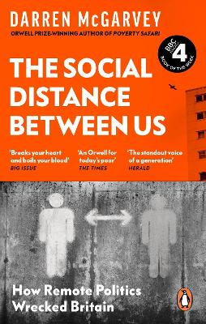
Social Inequalities Conference
Wednesday 25 September 2024
Darren McGarvey

Slide 3
Food Poverty as a cause of Health Inequality
Genna Millar & Lauren Bell

Slide 4
Our Vision
Our vision is that all children in Dundee will have their basic needs and rights met and that they will have opportunities to achieve their potential, regardless of circumstance.
Our impactful programmes supporting thousands of children annually.
We keep dignity at the heart of everything we do.

Slide 5
Poverty in Dundee
What is our why?
28.2%, nearly 1 in 3 children in Dundee live below the poverty line
This is higher than the national average of 24% and significantly higher than the Scotgov target of 10% by 2030.
The impact of the increased cost of living, fuel prices, covid etc on public resources, attainment in schools and life chances

Slide 6
Dundee Bairns
Our Programmes
Food and Activities - Fun and Food, Tea Clubs, Cooking Clubs
Clothing - Cosy Bairns
Home Essentials - Bairns at Home, Beds for Bairns
Fun and Food - 500,000+ meals in 7 years, cold packed lunches, delivered alongside activity
Tea Clubs - Two-Course evening meal delivered over the winter months
Cooking Clubs - supporting the teaching of vital life skills, cooking healthy meals on a budget

Slide 7
Nutrition & Poverty
Are very interlinked, they create a cycle which is very challenging to break
Nutrition is a Fundamental
Helps to reduce the risks of health related conditions and diseases,
There needs to be a reduction in health inequalities

Slide 8
Malnutrition
Poverty is a main factor for malnutrition
Limited Budget
Limited knowledge
Limited Time
Limited Cooking skills

Slide 9
Dundee Bairns Standards
33% of children between 2-15 at risk of being overweight or obese in 2022
Developing a easy to follow guide which will use a traffic light system
Increase in the number of kids developing anaemia and rickets

Slide 10
No Child Should Go Hungry
No Child Should Go Without

Slide 11
HOW HEALTH INEQUALITY IMPACTS OUR ABILITY TO LEAD HEALTHIER AND MORE ACTIVE LIFESTYLES
Louise Ballantyne
www.livingomni.com

Slide 12
Welcome!
I’m Louise...
Thank you for having me today...
I work with individuals facing barriers which prevent them becoming healthier as a result of health inequality...
Notes:
Hello everyone! My name is Louise, and I’m here because I believe in one simple truth: everyone deserves a shot at good health.
As a health and fitness coach, I work with people from all walks of life—teenagers like many of you here today, those struggling with chronic health issues, and individuals overcoming mental health challenges.
But there’s something standing in the way for many of us: health inequality.
Today, I am going to talk about what that means from a health and fitness perspective—and how you can break through it to lead a healthier, more empowered life.

Slide 13
NOT just some abstract concept.
Harsh reality that your health is often determined by your postcode, your income, or even your background.
These inequalities are unfair and avoidable, yet they affect millions of people every single day.
What is Health Inequality?
Notes:
Let’s get real—health inequality isn’t just some abstract concept. It’s the harsh reality that your health is often determined by your postcode, your income, or even your background. These inequalities are unfair and avoidable, yet they affect millions of people every single day.

Slide 14
In Scotland, men living in the most deprived areas die a staggering 13.4 years earlier than those in wealthier areas.
Women? About 9.6 years earlier.
Let that sink in.
That’s on average 11.5 years of life lost—because of circumstances they had no control over.
It’s not just about how long you live—it’s about how well you live, and for many, those final years are filled with preventable illness and suffering.
Notes:
In Scotland, men living in the most deprived areas die a staggering 13.4 years earlier than those in wealthier areas. Women? About 9.6 years earlier. Let that sink in. That’s nearly a decade of life lost—because of circumstances they had no control over. It’s not just about how long you live—it’s about how well you live, and for many, those final years are filled with preventable illness and suffering.

Slide 15
Isn’t just about lifespan—it’s about life quality.
In the UK, 20% of households face food insecurity.
In Scotland, only 56% of adults in the most deprived areas meet physical activity guidelines, compared to 76% in wealthier areas.
Education gap? Schools in struggling areas often lack the resources to teach students about fitness and nutrition.
Let’s
talk fitness...
Notes:
Now, let’s talk fitness. Because this isn’t just about lifespan—it’s about life quality. When you face inequality, it’s not just harder to get by, it’s harder to stay healthy.
• Low income? Healthy food might be a luxury you can’t afford. In the UK, 20% of households face food insecurity. Think about it—how can you focus on eating right if you’re worried about just getting through the week?
• Living in a deprived area? It can feel like the odds are stacked against you. In Scotland, only 56% of adults in the most deprived areas meet physical activity guidelines, compared to 76% in wealthier neighbourhoods. These stats aren’t just numbers—they’re real lives impacted.
• Education gap? Schools in struggling areas often lack the resources to teach students about the importance of fitness and nutrition. That means some of you might not even be getting the chance to discover the sports or activities that could change your life.

Slide 16
It doesn’t
have to be this way...
PHYSICAL ACTIVITY HAS THE POWER TO CHANGE NOT JUST LIVES, BUT THE FUTURE OF OUR COUNTRY...
Notes:
Here’s where I want to turn things around—because it doesn’t have to be this way. Physical activity is an absolute game-changer.

Slide 17
Did you know...
That regular physical activity can prevent 3.2 million cases of disease each year in the UK?
That exercise can even prevent 30 million GP visits annually?
That physical activity could save the UK healthcare system over £10 billion every year?
That regular exercise can reduce the risk of depression by up to 30%?
Notes:
I’m not talking about running marathons or spending hours in the gym. I’m talking about getting moving in ways that feel good for YOU.
Do you know that regular physical activity can prevent 3.2 million cases of disease each year in the UK? Imagine that—3.2 million lives improved because people found a way to stay active. Exercise can even prevent 30 million GP visits annually. And here’s the kicker—it could save the UK healthcare system over £10 billion every year. That’s money that could be reinvested into making health care better for everyone.
But it’s more than just the numbers. Exercise has the power to change your life. It’s not just about looking fit; it’s about managing and even reversing chronic conditions like heart disease, stroke, diabetes, and even mental health issues. Did you know regular exercise can reduce the risk of depression by up to 30%? That’s life-changing.

Slide 18
Physical Activity
24% of people in Scotland’s most deprived areas face mental health challenges compared to 16% in wealthier areas.
21.9% of Primary 1 children in Scotland are at risk of being overweight or obese.
But guess what? Physical activity can help turn that around.
Is not just going to the gym, lifting weights, running marathons...
Find something you enjoy and start reversing those statistics!
10 mins per day can change your life...
Notes:
Now, I get it. Some of you might be thinking, “That’s great, but how can I do that when I’m struggling financially or with anxiety, low confidence, or a health condition?”
Trust me, I’ve seen it all. But here’s the truth: you’re stronger than you think. Physical activity is NOT just going to the gym and running marathons.
• Mental Health? Physical activity can be your outlet. Yes, it’s hard to find motivation when you’re battling anxiety or depression, but just 10 minutes of movement can change your entire day. And let’s not ignore the statistics—24% of people in Scotland’s most deprived areas face mental health challenges compared to 16% in wealthier areas. This isn't just coincidence; this is a crisis we need to address head-on.
• Chronic Health Conditions? Even if you’re dealing with something like asthma or obesity, physical activity can help manage—and sometimes even reverse—these conditions. Obesity in deprived areas is skyrocketing; 21.9% of Primary 1 children in Scotland are at risk of being overweight or obese. But guess what? Physical activity can help turn that around.

Slide 19
So what can we do about it?
For Young People: I’m talking directly to you now.
You have more control than you think. Whether you’re into football, dance, or even just walking—find what moves you.
Start small, but start today. You don’t need to be an athlete; you just need to move.
I promise you, every step is a step toward a healthier, stronger, and more confident you.
Notes:
So, what can we do about it? We can’t fix this overnight, but here’s what we can do:
• For Teenagers: I’m talking directly to you now. You have more control than you think. Whether you’re into football, dance, or even just walking—find what moves you. Start small, but start today. You don’t need to be an athlete; you just need to move. I promise you, every step is a step toward a healthier, stronger, and more confident you.

Slide 20
So what can we do about it?
For Teachers and Professionals: You are the frontline in this fight against health inequality.
You have the power to create an environment where students feel supported, where they learn not just about academics but about taking control of their health.
Notes:
• For Teachers and Professionals: You are the frontline in this fight against health inequality. You have the power to create spaces where students feel supported, where they learn not just about academics but about taking control of their health.
Make fitness and well-being part of the curriculum in all subjetcs—programs that engage and inspire students, no matter where they come from.

Slide 21
So what can we do about it?
For Communities and Policy Makers: We need to push for real, structural change that lasts.
That means funding local initiatives that provide access to healthy food and creating safe spaces for exercise.
It’s about offering real opportunities to everyone, regardless of their background.
Notes:
• For Communities and Policy Makers: We need to push for real, structural change. That means funding local initiatives that provide access to healthy food and creating safe spaces for exercise. It’s about offering real opportunities to everyone, regardless of their background.

Slide 22
To conclude...
To the young people:
You have the power to change your story. You don’t have to be a victim of circumstance. You can take small, powerful steps every single day to take control of your health. And I’m here to help you do it.
To the teachers and professionals:
Together, we can build environments that foster fitness and self-confidence.
I’m ready to help you to make that happen—to create real change in and out of school and to change the future of our country.
Notes:
Let’s be real—health inequality is a massive challenge. But I’m not here to focus on what we can’t do—I’m here to tell you what we can do. We can fight back. We can make sure that everyone has the chance to live a healthy, active life.
To the teenagers: You have the power to change your story. You don’t have to be a victim of circumstance. You can take small, powerful steps every single day to take control of your health. And I’m here to help you do it.
To the teachers and professionals: Together, we can build environments that foster fitness and self-confidence. I’m ready to work with you to make that happen—to create real change in your schools, for your students.

Slide 23
1:1 and group support
How I can help....
Education programmes
I commit to playing my part in reducing health inequalities...
Events & public speaking
Notes:
I am committed to playing a part in this too. My promise to you all is that I will continue to offer bespoke coaching, group sessions, education programmes and events to help break down these barriers.
The last thing I want you to do is get your phone out and take a picture or scan the next two slides…

Slide 24
Scholarship Coaching Spaces Available...
www.livingomni.com/health-inequality
Notes:
whether you’re a young person looking for a way to improve your fitness, a teacher wanting to bring more health education into your school, or a professional seeking support, I have something very special for you so take your phones out scan this code. I want to give two young people in this room today a scholarship place on my 1:1 coaching programme to really help you take control over your health. I’m ready to help YOU unlock your potential. If you'd like to apply, nominate or find out more, please scan this QR code or get in touch via the details on the next slide.

Slide 25
Thank you for listening today...
Let’s connect and feel free to send over any questions...
louise@livingomni.com
@lou_livingomni
www.livingomni.com
Notes:
Thank you so much for listening today. Its been an absolute honour to be here with you all. I have included references in the next slide and if anyone has any questions, my contact details are on screen now.
Let’s make health and fitness a reality for everyone—no matter their starting point.
Thank you

Slide 26
References
National Records of Scotland (2021) Life expectancy in Scotland, 2018-2020.
Food Standards Agency (2022) Household food insecurity: main report.
Scottish Government (2019). Scottish Household Survey: Key Findings 2019.
British Heart Foundation (2017) New report assesses impact of physical inactivity on UK heart health and economy.
UKActive (2022) Government must change its muddled approach to physical activity policy.
Public Health England (2019) Health matters: physical activity – prevention and management of long-term conditions
NHS (2024) Exercise for Mental Health
Scottish Government (2023) Mental Health Equality Evidence Report 2023
Public Health Scotland (2023) Primary 1 Body Mass Index (BMI) statistics Scotland School Year 22/23

Slide 27
What causes health inequalities
Dr K Nicolson MRCGP MPH
University of ST Andrews/ GP Dundee

Slide 28
The GAP
‘People in most deprived areas spend
1/3 of their lives in poor health’
https://www.nrscotland.gov.uk/files//statistics/healthy-life-expectancy/19-21/healthy-life-expectancy-19-21-info.pdf

Slide 29
Male life expectancy difference

Slide 30
What do people think?
https://www.health.org.uk/evidence-hub/money-and-resources/poverty/relationship-between-poverty-age-and-health

Slide 31
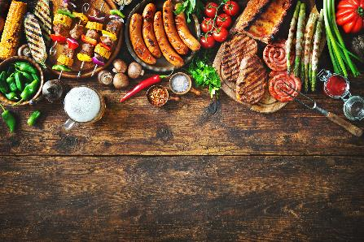
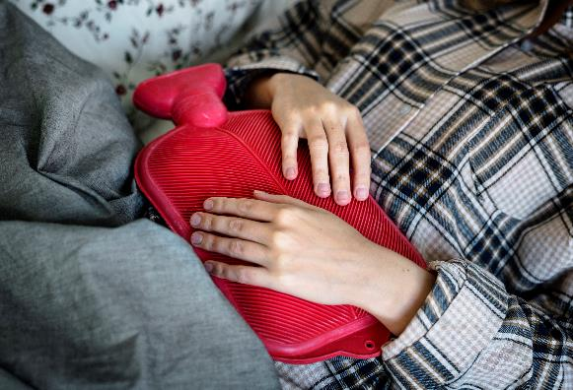
What is poverty? ‘Unmet Needs’
World Health Organisation
‘ lack of resources’ to obtain food, participate in activity, have the living conditions’ custom to the society they belong’
Joseph Rowntree Foundation ‘ no single best measurement’
Households ‘ less that 60% median income’
Material deprivation but also shelter/heating/clothing/food

Slide 32
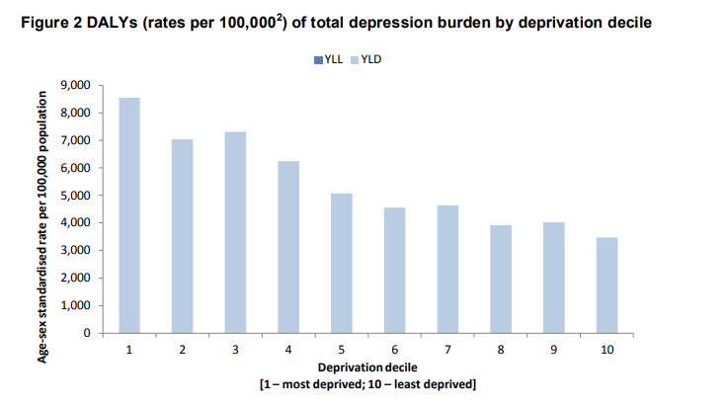
What does Living in poverty do to the human body?
Stress – physiological, chronic
Experience:
Hunger
Poor Sleep
Poor relationships
Environment – cold/mould/pollution
Affects Mental Health

Slide 33
Poverty Effects
Low socioeconomic status affects health as much as
Smoking
Physical Inactivity
Harmful Alcohol
Unhealthy diet
https://www.thelancet.com/journals/lancet/article/PIIS0140-6736(16)32380-7/fulltext

Slide 34
What impacts our health?
‘ Society can make you sick or can promote your health’
https://doi.org/10.1016/j.amepre.2016.09.010

Slide 36
Health inequality ‘ unfair & Unavoidable’
Access to health resources is not equal
Inverse Care law ‘ those who have the most need, have the least’
Health inequality related to illness and death
‘Scotland had the highest avoidable mortality rate in 2019 with 307.8 deaths per 100,000 people, which was statistically significantly higher than the rates for the other three countries’
https://www.kingsfund.org.uk/insight-and-analysis/long-reads/what-are-health-inequalities
https://www.instituteofhealthequity.org/resources-reports/health-inequalities-lives-cut-short/read-the-report.pdf

Slide 37
Mortality - death

Slide 38
Causes of Death

Slide 39
Chronic health problems
Leading cause of death in the world
‘ Physical inactivity, poor nutrition, tobacco use and excessive alcohol’
Improve social determinants of health to reduce the impact of chronic disease
https://doi.org/10.1016%2Fj.mayocpiqo.2023.08.005

Slide 40
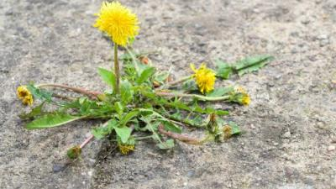
Hope ‘SPECTACLES TO SEE SPECTACULAR HOPE’
‘Don’t be afraid of being a dandelion’
Bring others along with you
Health care needs you!
Compassionate and empathetic
Voice for those with no voice
Stay passionate

Slide 41
Alcohol and Health
Carol Bailey – SafeZone Coordinator

Slide 42
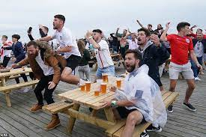
Celebration and good times!

Slide 43
Deaths 2023-2024
National Records of Scotland show 1276
Generally, there has been a steady rise since 2012 – now highest since 2008
Males account for 66% although the increase from the year before (31) were all female
Always higher in deprived areas

Slide 44
Most at risk?
Lady in mid 50s
Doesn’t work
Meets gym friends most days for lunch – has small wine
Has G&T with husband when he finishes work
Share a bottle of wine with evening meal
Man in early 30s
Works offshore 4 weeks on then 4 weeks off
Comes home and meets friends and go out on a ‘bender’
Can’t remember the evening when wakes up the following morning

Slide 45
What is 14 units?
5 pints
6 glasses of wine - 175ml

Slide 46
Health risks 10-20 years of 14+ units weekly
Mouth, throat and breast cancer
Stroke
Heart disease
Liver disease
Brain damage – brain not fully developed until 25 years old
Central Nervous System damage
Mental health issues – denial, self-loathing, feel/look older

Slide 47
Problems
Alcohol is legal to obtain
Widely available
Perceived as an integral part of most social occasions
No limits to amount you can buy (funds permitting)
Available prior to full brain development
More expensive in small ‘corner shops’
More affluent can afford counselling and diversionary activities
Different qualities of alcohol

Slide 48
Obesity and Inequality in Scotland
Maia Quail
Policy and Partnerships Officer
Notes:
Good morning, my name is Maia Quail and I am the policy and partnerships officer for the Scottish Obesity Alliance and I’m here to talk to you about obesity and inequality. So just for a bit of context the Scottish Obesity Alliance brings together lots of different organizations who have an interest in reducing obesity and making Scotland a healthier place for people to live. We try to get policy makers in the government to improve policy and practice on obesity prevention in Scotland.

Slide 49
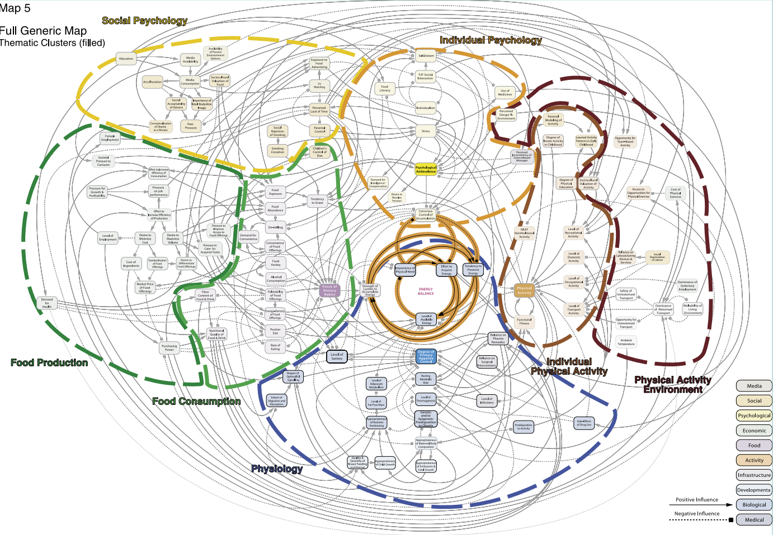
Notes:
Obesity is a much more complicated issue than most people realize. It's not just about exercise or what you eat, it’s a huge web of factors all tangling together that influence a person's weight. The diagram behind me is from a famous 2007 UK government report called the Foresight report, this diagram is fiendishly complicated and shows all the factors that can influence a person’s weight. Looking at this diagram show’s just how many factors are involved! Your genetics play a role, but so does where you live and go to school, your family's health habits matter, and even things like what medications you take or how much money your family has can make a difference.
Now, I can't cover everything about obesity in one go, but here's what I want to focus on:
1. A quick overview of what obesity actually is
2. Why it matters to you as young people in Scotland
3. What our government can do to help make Scotland healthier place for its citizens

Slide 50
What do you know about obesity?
Notes:
Let's talk about what obesity actually is, so in it’s simplest definition it is someone carrying a lot of extra weight, in the form of body fat. But remember, we're talking about people here, so we always say someone is "living with obesity" rather than them being obese – it's a health condition, not who they are as a person.
With that in mind, Scotland actually has more people living with obesity and overweight than anywhere else in the UK.
Living with obesity can seriously impact a person's life. It can affect your health, make it harder to work, and hang out with friends. Basically, it can change how you live your day-to-day life. That's why it's super important, especially for us in Scotland, to figure out ways to bring these obesity rates down. It's about helping people live healthier, happier lives and it isn't about shaming anyone. It's about understanding a big issue that affects a lot of people in our country and thinking about how we can change this.

Slide 51
How many people live with overweight and obesity?
Notes:
Let's talk numbers for a second. So, let's start off with young people first, so imagine this is the entire population of young people living in Scotland. As of 2023, 33% of young people so a third of young people in Scotland are living with overweight and obesity. And for adults, the figure its even higher, actually about double, 67% of adults in Scotland are living with overweight and obesity - that's two out of three adults!
We're talking about a huge part of Scotland's population here. And it matters because living overweight or obesity isn't just about size – it can lead to a plethora of other health issues. Including:
- Type 2 diabetes
- Some types of cancer
- Tooth decay
- Depression and anxiety
That last one's really important. We now know there's a strong connection between carrying extra weight and feeling down or anxious.
All these extra health problems make it even tougher for people living with overweight and obesity. This is why it's such a big deal for Scotland. We're not just talking about numbers on a scale, but about the overall health and happiness of a huge chunk of our population.

Slide 52
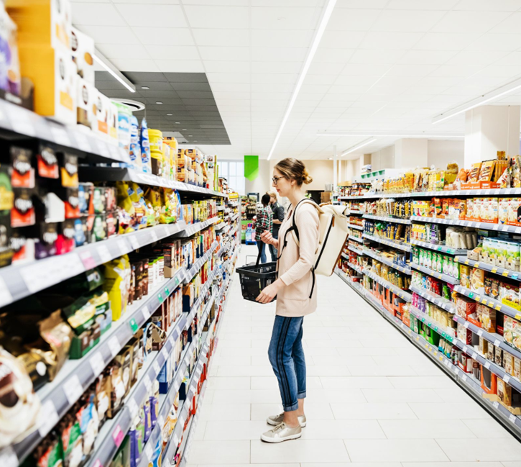
But what about inequality?
Notes:
Inequality is a major cause of obesity. Young people who live in the most deprived areas of Scotland are twice as likely to be at risk of obesity compared to their peers from the least deprived areas and we see this trend in adults especially women.
To illustrate this even better I’m going to play a video, it’s very short and it is based off research that we did together with the University of Glasgow on young people like yourself in Scotland.

Slide 54
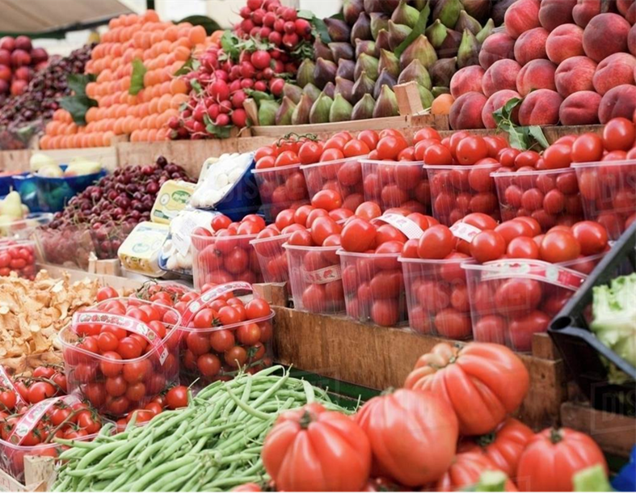
But what about inequality?
Notes:
The harsh reality is that where you live and how much money you have can seriously affect your health. It's not fair, but it's true.
Picture this:
If you're from a less well-off area, you're probably surrounded by more junk food options.
Your local shops might not have great healthy choices and these factors all contribute to making it harder to maintain a healthy weight in these areas.
Now, even if you want to try eat healthy food, it costs way more than junk food. Research shows that healthy food is around double the price per calorie compared to unhealthy food!
If you're from a more deprived area, eating the recommended healthy diet would cost you half of your disposable income. Half! People simply cannot afford that. So when we talk about tackling obesity, it's not as simple as saying eat less, move more, we need to look at tackling inequality.

Slide 55
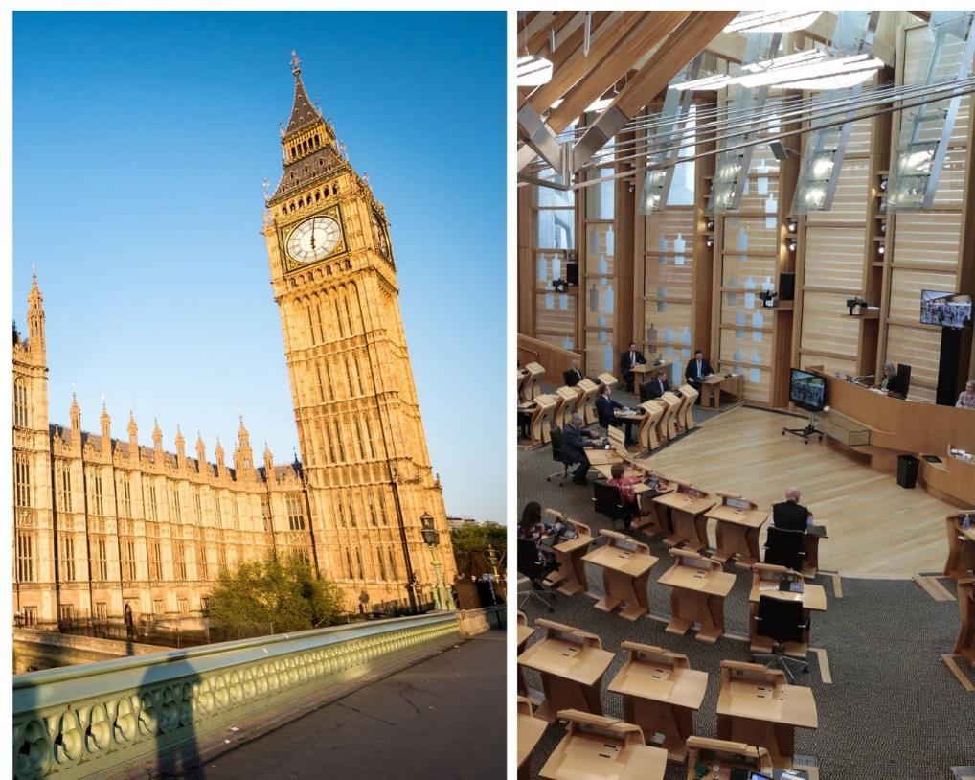
Who can help us make Scotland healthier?
Notes:
So, who's gonna help us turn Scotland into a healthier place? Spoiler alert: It's not just about individual willpower.
We need a team effort from:
- The Scottish and UK governments
- Local councils
- MPs and MSPs (those are the folks who represent us in government)
1. Flip the script on food prices:
You've probably noticed it's way cheaper to buy a multipack bag of crisps than a single bag. Things like this make it harder to stay healthy. It’s also cheaper to buy crisps and sweets than it is to buy fresh fruit and vegetable. We need to change this.
2. Bring healthy food closer to home:
For some people especially those in more deprived communities, getting to a supermarket with fresh fruit and veg is like a mini-adventure – multiple bus rides and all. That's not cool. We need to make sure everyone can easily access nutritious options.
3. Smarter city planning:
When we design our towns and cities, we can set things up to naturally encourage healthier choices. This is where local councils come in big time as they're the ones that give planning permission. Whether that’s restricting fast food outlets in an area, ensuring local supermarkets near housing developments or making areas walkable, local councils can influence all of these things which in turn help people lead healthier lives.
Here's some breaking news: The Labour government just announced in the last week or so that they're cracking down on junk food ads targeting young people. Starting October 2025:
- No more unhealthy food commercials on TV before 9 PM
- A total ban on paid online junk food ads
This is great news it's a good example of how smart policies can help people be healthier without putting all the pressure on individuals.
The big takeaway? Making Scotland healthier isn't just about personal choices – it's about creating an environment where the healthy choice is the easy choice for everyone.

Slide 56
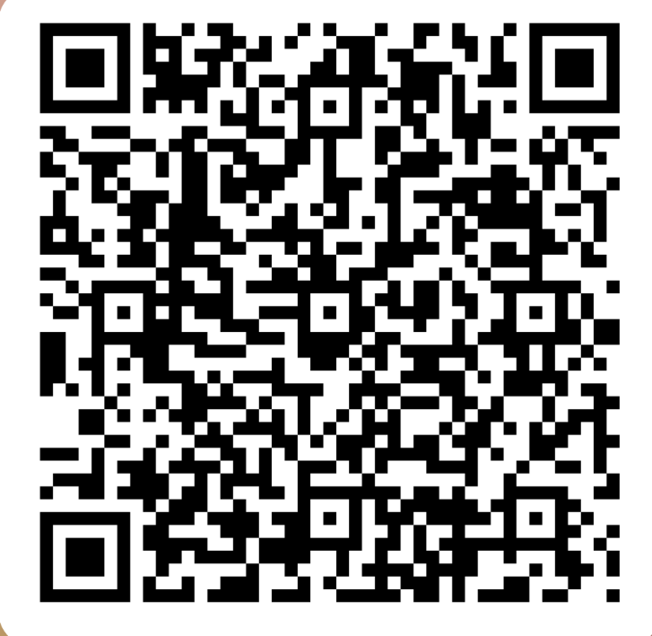
Now we want to hear from you!
https://forms.office.com/e/MkxRFMRJ8U
Notes:
Now we want to hear from you! If you can scan the QR code now or go to the link on the screen and fill in this quick survey. It will take 30 seconds if that!
Young people are at the focus of legislation to restrict advertising of unhealthy foods. We want to collect data on how you feel about being bombarded with unhealthy food advertising, and what you think about trying to make Scotland healthier. We’re hoping to use this data to influence policy makers and ministers in the Scottish Government, so your voice is really important here. tell us what do you want to see happen in Scotland to help people be healthy? Do you want cheaper healthier food, do you want more cycle lanes? Do you want healthier restaurants and cafes? Okay that’s great, well thank you so much everyone for participating. I’ll be here all day so please come up and have a chat with me.

Slide 57
Joy Melville Tenant Services Manager Hillcrest Homes
Notes:
Note one of the largest Housing Associations in the east of Scotland.

Slide 58
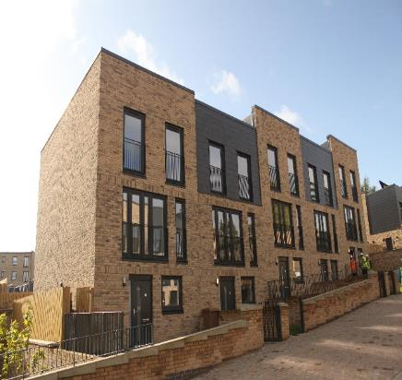
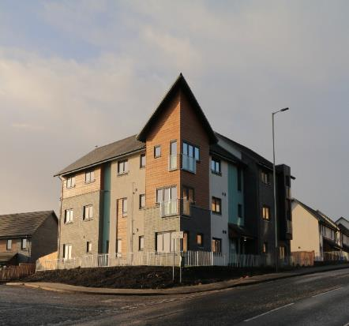
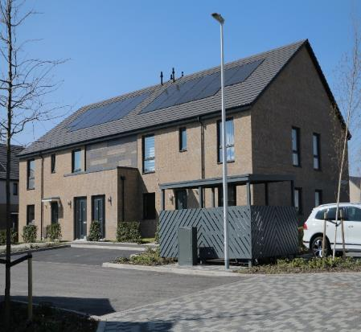
What are the different types of housing in Scotland?
Housing tenure describes the legal status under which people have the right to occupy their accommodation. The most common forms of tenure are:
Home-ownership: this includes homes owned outright and/or mortgaged
Renting: this includes social rented housing and private rented housing
Notes:
Note: difference between social (not for profit) private (commercial for profit) today we will focus on rented homes

Slide 59
What are the different types of rented housing in Scotland?
Private let – this includes mid-market properties
Renting from someone who lives in the same property
Subletting from a tenant
Social Housing
Homeless, temporary or supported accommodation
Accommodation provided by employer
Mobile home/Park home
Rented agricultural land
Property own by the armed forces
Property rented from the crown
Notes:
As you can see there are lots of different types of rented properties and within these categories there are also sub categories – and all have different regulations and quality standards.

Slide 60
Poverty/Poor Housing/Health
The quality of housing has major implications for health. Poor housing is associated with a wide range of health conditions such as respiratory diseases including asthma, cardiovascular diseases, injuries, mental health and infectious diseases including tuberculosis, influenza and diarrhoea. Housing is increasingly important to public health due to demographic and climate changes. The major health risks associated with poor housing conditions fall into 4 main areas:
Damp, mould and condensation
Low temperatures (indoors and outdoors)
Inadequate living space (over-crowding);
Injury hazards in the home;
Notes:
Note: Looking at the poor housing conditions that can lead to poor health these are all further impacted by poverty. Damp/M/C – people unable to adequately heat and ventilate their homes could end up with dmc that impacts their health, overcrowding can lead to mental health issues and people living in poverty have less housing choice as they cannot afford to move, injuries – from repairs not being done…..safety issues such as cladding

Slide 61
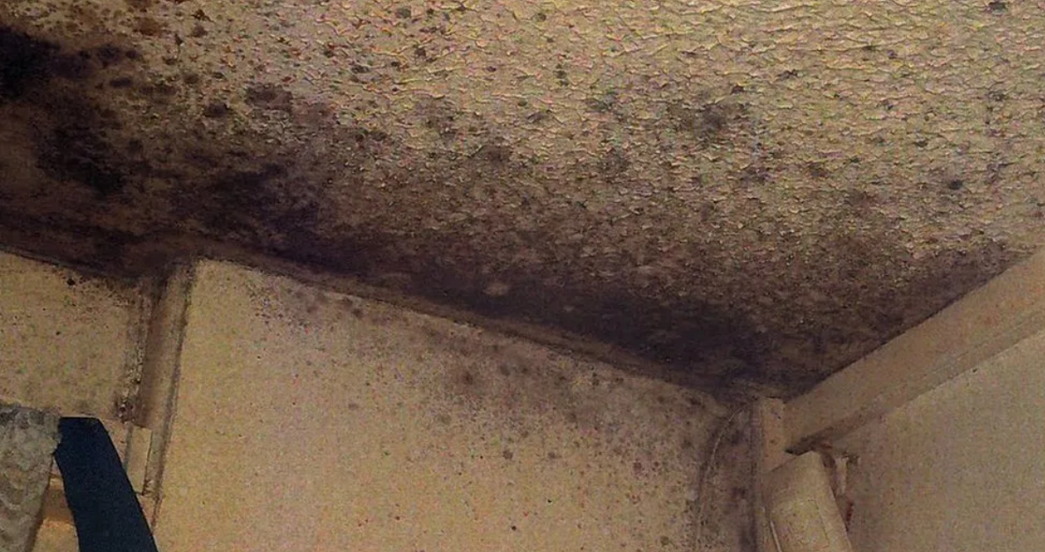
Notes:
Note: I’d like to you focus for a moment on this picture – it is shocking!

Slide 62
Poverty/Poor Housing/Health
As previously mentioned, poor housing can cause or contribute to damp, mould and condensation in the home. The picture you have just seen is from the home where two-year-old Awaab Ishak died recently from a respiratory condition caused by exposure to mould in his home in Rochdale. His family had complained about the issues to their landlord for a long time and no action was taken to help resolve the situation. All landlords (private and social) have a responsibility to make sure homes are safe and in good repair. It is the landlord's responsibility to fix a mould problem.
Notes:
Note: Looking at the poor housing conditions that can lead to poor health these are all further impacted by poverty. Damp/M/C – people unable to adequately heat and ventilate their homes could end up with dmc that impacts their health, overcrowding can lead to mental health issues and people living in poverty have less housing choice as they cannot afford to move, injuries – from repairs not being done…..safety issues such as cladding

Slide 63
Poverty/Poor Housing/Health
What can cause or contribute to damp, mould and condensation in the home:
Low quality housing that is poorly insulated, drafty or has insufficient or faulty heating
Low income meaning residents can’t afford to heat their homes
Lack of ventilation (if a property is already cold residents reluctant to open windows) Not taking away from the terrible health issues caused by poor housing, there are some measures that can be taken to help reduce or help to prevent the possibility of damp, mould and condensation in the home. At Hillcrest, we have created a short video to advise our tenants of how they can do this:
Notes:
Note: Looking at the poor housing conditions that can lead to poor health these are all further impacted by poverty. Damp/M/C – people unable to adequately heat and ventilate their homes could end up with dmc that impacts their health, overcrowding can lead to mental health issues and people living in poverty have less housing choice as they cannot afford to move, injuries – from repairs not being done…..safety issues such as cladding

Slide 65
Social Inequality in Communities
Social inequality is the condition of unequal access to the benefits and rights of society. We have touched on a few of the issues that link poor housing and poor health. People living in poverty are more likely to be in poor housing as they have less choice over where they live:
Inability to access a mortgage due to low income
Inability to pay higher private rent (including security deposit)
Lack of affordable housing in the area
Low priority if in an existing tenancy as classed as “adequately housed”
Notes:
Note:

Slide 66
Social Inequality in Communities
Is there any good news?
In recent years both the UK and Scottish Government have had a focus on providing more social affordable housing which is heavily regulated around quality standards. Unfortunately, due to budget cuts in both governments these budgets have unfortunately been reduced. The Housing (Scotland) Bill is a Scottish Government Bill introduced in the Parliament on 26 March 2024. The Bill deals mainly with rented, particularly private rented, accommodation and homelessness prevention. The Scottish Government states that the package of reforms, "will help ensure people have a safe, secure, and affordable place to live…while contributing to the ambition to end homelessness in Scotland."
Notes:
Note: Although budgets have been cut housebuilding in the social sector does still continue, but demand continues to massively outstrip demand. At any time in Dundee there are upwards of 8000 on a waiting list for social housing.
Any legislation to improve housing standards is welcomed but there are parts of the Bill that are not welcomed by the sector (no time today) and there will always be families who will sadly slip through the net/cracks

Slide 67
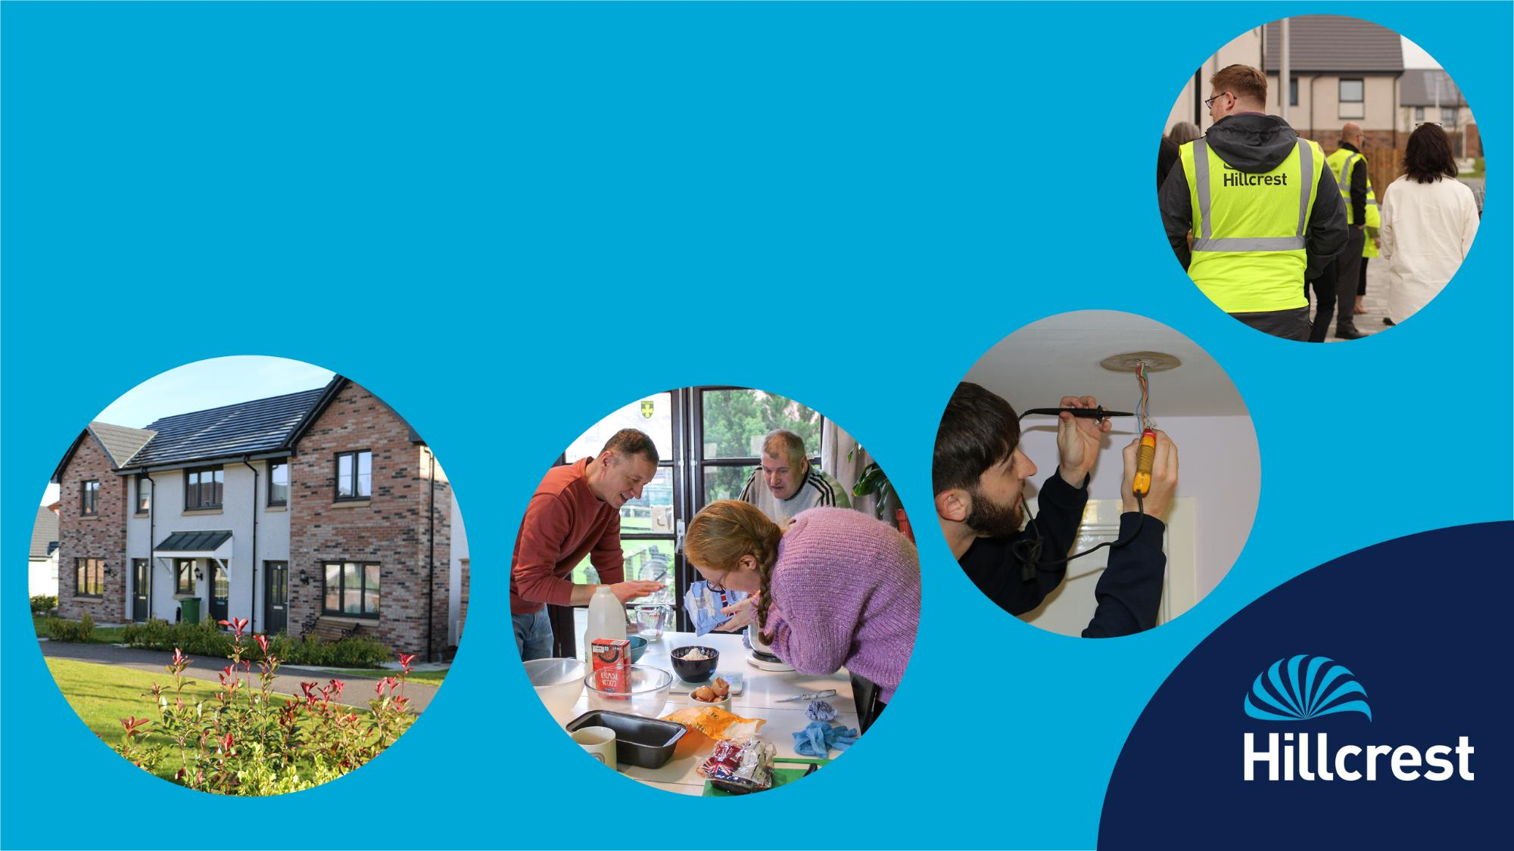
Thank you!
Notes:
Note: thanks to Miss Douglas for inviting me along today and thank you for listening to my presentation. I will be around all day and I’m always happy to have a chat so if you have any questions, please feel free to come over and ask.

Slide 68
The Impact of Drug Use on Health Inequalities
Bobbi Murray & Sam Garty-Sinclair
Positive Steps Outreach Team

Slide 69
Agenda
Mental Health Consequences of Drug Use
Impact of Drug Use on Physical Health
Impact of Drug Use on Social Well-being
Social and Economical Factors Contributing to Drug Use
The role of Positive Steps
Lived experience

Slide 70
Mental Health Consequences of Drug Use
Drug Use can lead to mental health disorders for example anxiety, depression, and psychosis, worsen existing mental health conditions.
Barriers to accessing mental health
support
Addressing mental health imbalances
Individuals facing health inequalities may encounter barriers in accessing mental health support, increasing the impact of drug use on mental well-being.
Efforts to address mental health imbalances related to drug use can help reduce health inequalities and improve overall well-being.

Slide 71
Impact of Drug Use on Physical Health
Physical health complications from drug misuse
Social factors and physical health outcomes
The long-term consequences of drug use include chronic health issues, increased mortality rates and a burden on healthcare systems. These effects disproportionately impact marginalised communities, increasing health inequalities.
Social factors, such as stigma, play a significant role in determining the impact of drug use on physical health outcomes, increasing existing health inequalities.
Promoting easier access to healthcare services
Efforts to promote easier access to healthcare services can lessen the impact of drug use on physical health and reduce disparities in health outcomes.

Slide 72
Impact of Drug Use on Social Well-being
Social consequences of drug use
Community interventions and social support
Empowering marginalised communities
The stigma of drug use can lead to social consequences such as unemployment, homelessness and social isolation, imprisonment contributing to health inequalities.
Community interventions and social support systems play a crucial role in addressing the social impact of drug use and reducing health inequalities.
Empowering marginalised communities through targeted interventions can mitigate the social impact of drug use and promote health equity.

Slide 73
The Role of Positive Steps
Positive Steps work with local and national organisations to improve health and social welfare. Our programmes address health issues linked to poverty, substance use and homelessness, through education, training and support.

Slide 74
Positive Steps
Crisis Response Outreach Service (CROS)
Non-Fatal Overdose Pathway (NFOD)
Chance to Thrive
Supported Accommodation
Cuckooing & Trauma Service (COS)
Custody Arrest Referral Service (CARS)
Positive Pathways
Housing Support

Slide 75
“Being a drug addict is one of the loneliest lives imaginable. Because of my heroin addiction all my decent friends gave me a wide berth and if I’m honest I don’t blame them, between them and my family I now live an isolated life. I’m in recovery now and because of that I’ve had to isolate myself, the reasons being there is too many people out there eager to rope you back into drugs not because their your friends it's because they want your money. I wish I could turn back the time because I would do a lot of things different”.
“”
”
Quoted from an individual with lived experience, who is receiving support from Positive Steps

Slide 76
My diseased mind Being an addict with the disease of addiction can be daunting its like demons and ghosts are always there with the darkness fearfully haunting. So difficult to get that dunt always running and chasing. Up and down with your mood, mind and heart racing. Tasting all drugs, hooked after the first smoke Not being in reality it was just a lie, one big joke. Devil chasing me from morning, noon and night. Always bad thoughts as my mind picks a fight. Fighting myself afraid of what I could become Looking back it was so painful, misery is no fun. Obsessive thoughts makes me very sick Living with a disease in my mind leaves my mind foggy and thick. I pray for brighter and peaceful days ahead As I’m clean trying to be a better person and live in the moment instead.
“
”
A poem from individual with lived experience, who is receiving support from Positive Steps

Slide 77
Summary
“Drug misuse” encompasses the inappropriate use of prescription medication, illegal drugs and over-the-counter substances. It can lead to severe health consequences, physical health deterioration and mental health issues.
Individuals who use substances face a multitude of challenges regarding their physical and mental health.
Addressing health inequalities stemming from drug use requires a multifaceted approach. By understanding the root causes and implementing comprehensive strategies, we can work towards a healthier, more equitable society.

Slide 78
Thank you
Sam Garty-Sinclair
samgarty@positivesteps.org.uk
Bobbi Murray
bobbimurray@positivesteps.org.uk

Slide 79
PDA in Service Design (PDSDES24X1DB) Tools & Methods Assignment
Bryan Smith

Slide 80
This Project
This project will use the principals and tools of service design in looking at several issues My project is based on a current experience within the workplace:
The development of a feedback system for participants which considers their complex needs.
This has been a long-term problem, due to the difficulty in gathering feedback that is constructive and useable by the service.
By using the service design tools, I hope to be able to design services within Transform Community Development in a way that enhance the experience for all stakeholders.
Transform Community Development is dedicated to fostering the growth of resilient communities. Through our strength-based initiatives, we offer a diverse range of services, including housing support, supported accommodation, food re-distribution and a furniture project.

Slide 81
About us
Transform Community Development is dedicated to fostering the growth of resilient communities. Through our strength-based initiatives, we offer a diverse range of services, including housing support and supported accommodation. Our temporary residence at 10 Brewery Lane and the pioneering housing first programme are prime examples of our commitment. Additionally, we proudly run FareShare Tayside & Fife and Transform Furniture, further showcasing our dedication to community development. With our holistic approach, we're not just offering services; we're transforming support for a brighter future

Slide 82
Where are we?
What we do
Why is doesn’t work
Service users have access to
Paper feedback forms
e-feedback forms
1-to-1 support review sessions
Focus groups
Paper is not returned, responses unusable, used for other purposes.
Limited interest in giving feedback.
Attendance poor due to competing priorities

Slide 83
Why do we need feedback?
Service improvement
Contractual & regulatory requirement
Allows those who use the service to have a stake in service development
Identifies & supports the training & development of staff

Slide 84
Why a service design approach
Using a service design model is a way to create a tailor-made solution to problem, which gives the best solutions for the organisation and the users and produces a service that works.
I have adopted a service design approach due to the difficulties we can have in service user engagement, and I hope that by using a systematic and evidence-based model, we can refine our approach and better understand the expectations of those using our service. The hope is to develop better service which will “explain what is needed from the user to complete the service and what that user can expect from the service in return” (Downe,2020, p67).

Slide 85
“Instead of worrying about getting it right first time, we can evolve a range of options, and rely on the structure process of prototyping and testing to test and improve our work”
(Stickdorn et al., 2018, p. 14)

Slide 86
The Double Diamond
The Double Diamond Process provides a framework for the design of a solution. The shape of the diamond emphasises the process diverging and focusing, allowing the designer to move from the defining the problem to formulating a solution in a structured manner. We start with discovering the nature and scope of the challenge, then take the information collated via tasks such as service user interviews, focus groups and workshops.
Once this information is “discovered” we can begin to define the problem, by distilling the information and stating the service users’ needs and problems. From here we can begin the process of developing a solution, these can be inspired by other examples within the field (or from an unrelated industry). Finally, these potential solutions are refined to a point where a bespoke outcome is delivered for the service.
Design Council, 2024

Slide 87
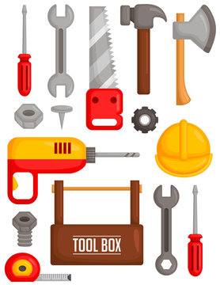
Five chosen tools
I have chosen the following five tools as they support the service design process outlined in the Double Diamond and cover the Discover, Define, Develop & Deliver stages within the process.
Empathy mapping
Personas
Problem framer
ABC avalanche
Service blueprint

Slide 88
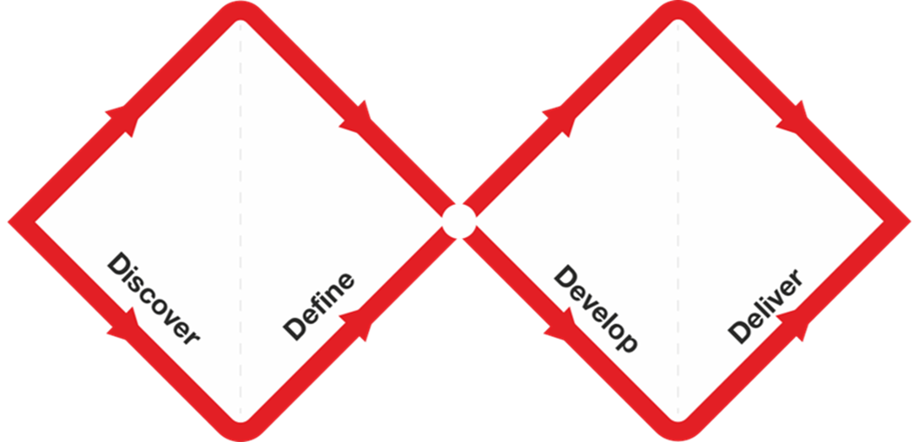
Tools use within Double Diamond
Empathy mapping
ABC Avalanche
Blue printing
Personas
Problem framer

Slide 89
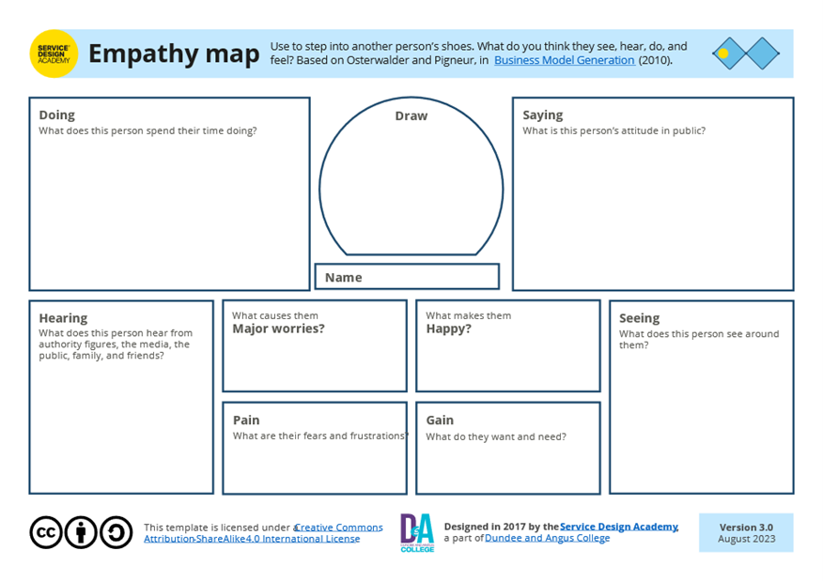
Empathy mapping
Empathy mapping is the process of finding out what all parties involved in the design of the feedback loop want from the process, Most importantly it will allow all stakeholders a shared understanding of the feedback process and expectations.
Using this tool was very positive as it allow me to understand the cohort we to gain feedback from targeting, collect knowledge and experience from all parts of the organisation and stakeholders and help us begin to identify the main issues to resolve. Previously, we have introduced projects in an unstructured way, which has led to numerous problems and ultimately failure. (Osterwalder & Pigneur, 2010)

Slide 90
Empathy Mapping
Empathy mapping is the process of finding out what all parties involved in the feedback loop want from the process, Most importantly it will allow all stakeholders shared to understand the feedback process and expectations (outputs, not outcomes) Without this the process will not be relevant and used, as has been the case previously. The map was completed with a cohort of three defined groups:
Those who use our services
Staff group
Stakeholders (DCC, DHSCP, University of Dundee etc.)
The map has four quadrants SAYS, THINKS, FEELS, DOES. The participants were asked in three separate sessions:
Says: thoughts & opinions
Thinks: beliefs & principles
Feels: emotions & motivations
Does: actions & behaviours

Slide 91
Personas
By developing personas, considering the feedback from the empathy mapping we can better understand the needs, experience, behaviors and goals of those who use our service. It means that we can distil our service users into “personas that provide meaningful archetypes which you can use to assess your design development against” Dam & Teo (2024). This allows us to consistently appraise process against these personas.
The only communality that binds our service users is their differences, and I have found that by creating personas we have been able to develop an “average” service user for whom we can design for. It has allowed us to focus and not be distracted by new, atypical service user information.

Slide 92
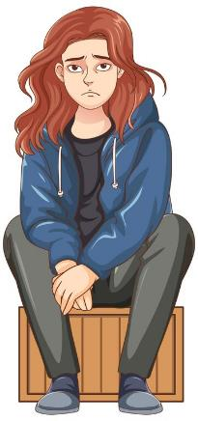
Alison
Age
Alison is 46
Saying
“I don’t trust people; I want to feel safe”
Interests
Used to like crafts, but hasn’t in a while due to circumstances
Work life
Currently on benefits, has not worked since being registered as homeless (2 years). Used to work in pubs.
Values
Being safe and “getting on”
Background
Originally from Edinburgh but moved to Dundee 10 years ago to escape domestic violence
Personal life
No contact with family in Edinburgh. She has a few “friends” in the accommodation, but they are superficial friendships.
Pain points
Doesn’t feel listened to or valued.

Slide 93
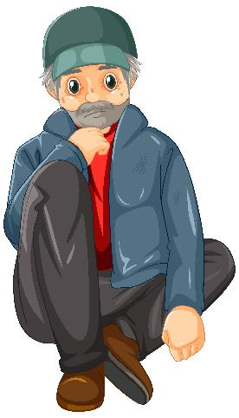
Trevor
Age
Trevor is 68
Saying
“Just leave me alone”
Interests
Likes to place small bets on horses and football.
Background
Born Kent, following 20+ years in the army, has drifted. Never married. Drinks 5 bottles of cider daily.
Work life
Joined the army and fought in the Falklands & Northern Ireland. Has not worked since discharge
Values
Friendship
Personal life
Has a close ex-military friend (the reason he came to Dundee), who he meets and drinks with most days.
Pain points
Doesn’t like drugs and the “youngsters” who use openly around the accommodation.

Slide 94
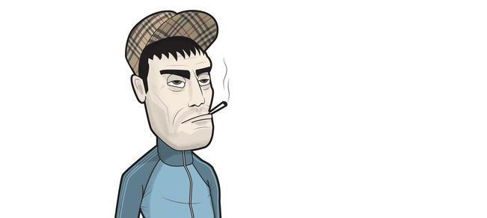
Derek
Age
Derek is 31
Saying
“I’m okay man, it’ll be fine”
Interests
Primarily “scoring”, does want to get his dog back.
Background
Born & bred in Dundee. Has used substances since his mid-teens, primarily heroin, but will use what’s available.
Work life
Never worked, due to his addictions, has every thought about what working would look like.
Values
Derek values loyalty more than anything else.
Personal life
Many “transactional” acquaintances. Has an on-off girlfriend, who is currently off, and has a dog who is cared for by her.
Pain points
Doesn’t see (or think) of the future. Lives in the moment.
The drugs may kill him, like they have to others.

Slide 95
Problem framer
We cannot solve what we do not know! Whilst we know there is a problem we need to define and frame. The data collected is analysed and synthesized to a point where the problem can be developed into a question.
We often run headlong into solutions without defining the question leads to confusion, poor solutions and tangential thinking, costing time and resources. Despite this we often revisit these poor solutions or use off the peg solutions as it is seen as easier and quicker.
“Innovation starts with finding problems” (Griffith Centre for Systems Innovation et al., 2024)

Slide 96
Feedback
Improved service delivery
The process is accessible and easy with clear action plan to comments
Quality & quantity of feedback is not good
Time to complete
Too complex
No action taken after feedback given
Easy to submit, high quality information is received, and action is feedback in a timely manner
Engagement
IT requirements
Promotion
Dependable on cohort at the time
Personas
Blueprint
Review

Slide 97
ABC Avalanche
The next part of the process is the development of solutions. I have chosen ABC Avalanche, it’s but a highly effective ideation tool, as it gives us a wide range of potential solutions based on the letters of the alphabet.
We gathered the group and asked everyone to write down their thoughts on a topic and stick them onto a flipchart page with boxes for each letter. It allowed us to gather a large range of ideas quickly, using participants own words, giving them ownership of their ideas.. This method works because participants have ownership of their views and ideas. It also felt as though it gave equal weighing to the ideas and given the cohort, we were working was it was vital

Slide 98
Available to all
Brief
Creative
Direct
Easy to complete
Fun
How do we gather high quality feedback from those who use our services?
Genuine
Honest
Inclusive
?
Mundane
Non-
Judgemental
?
Legible
On-line
Paper copies
Quality
Real answers
Suitable
Thorough
User friendly
Visual
Worth-
while
EXciting
?
Use of Zero

Slide 99
Service blueprinting
The service user journey is multi-factoral, and a service blueprint is a tool to bring together all these together and better understand the interactions between the “front of house” and “backstage” and how this relates to the timeline.
Central to this process in getting users to participate and better their experience, so “the prototype can generate tangible evidence on which solution can be founded” (Stickdorn & Schneider, 2012, p.192)
The “front of house” is where the user interacts with the service whether it is in person or process. Backstage is what happens with the users' interactions, how are these interaction processed, what systems are required to process and who is involved. A blueprint should be an objective start to finish but “uses the customer experience as starting point, and unpacks it to expose how the organization supports that journey” (Miller & Flowers, 2016)
By prototyping produced several refinements which helped us iterate the solution e.g.
Increasing the number of multiple-choice questions, to minimise service users formulising answers.
Changing the wording of questions to better the user experience.
Changing the scoring system to become more nuanced.

Slide 100
Curiousity
Reflective
Apathy
Request or pick up form or access IT
Submit electronically
Posters
Distribute form
Collect from user
Collate data
Disseminate data & action plan
Knowledge of access points
Input paper copy into database
Microsoft Forms

Slide 101
Core tools
Journey mapping
The diagram demonstrates where within the Double Diamond journey mapping sits.
There remain one more tool that is core to the design process but has not been described in this portfolio i.e.
Journey mapping

Slide 102
Journey Mapping
Simply put a journey map is a visual representation of the user experience. on the journey it can be as simple or complex as required or wanted. It breaks down the user experience into its component parts allowing us to ascertain their actions, thoughts, emotions and opportunities (Digital for Good, 2024) Previously I have looked at developing personas as archetypes of our service users. Modelling the personas experience the map, allows us to better understand the motivations and expectations, thus to “communicate an understanding of {our} service to all involved” (Gibbons, 2024b).
The map will show the points where the user interactions directly and indirectly with the service and walk through the whole experience.
Once the information is gathered, we can begin to identify solutions to improve the experience, these can be prioritized using other tools such as an idea matrix.

Slide 103
Ideation
Ideation is the generation of ideas for create solutions.
Within the process, it comes after the problem has been identified and defined, it is only at this point that ideas can be looked at to meet a solution. This process should encourage all ideas equally, no matter how mad they may initially seem, and generating a volume allows us to look at building new ideas from blending different thoughts.
Ideation is about thinking out the box and looking at innovative solutions to problems, involve service users and other members of the team to tap into their experiences and views. Everyone has a different perspective on how a service operates, and the breadth of ideas generated by a wide range of people will support innovation.
I have used ABC Avalanche as a tool to generate ideas, but there are others such as RIP+MIX which involves visualizing a good service and the problem, then using aspects of the good service to solve the problem

Slide 104
Ideation
We develop an ideation team, which consisted of staff & service it was a team that spanned the experience require in terms of age, experience, gender etc.
Prior to commencing we insured that they understood the current system and what other feedback systems looked like so they could contextualise the process.
We used a whiteboard & Post-It notes to explore ideas and order them using the How-Wow-How matrix
Outcomes
Easy access via IT & paper
Easily availability
Use of rating scales
No more than 10 questions
Ability to give furthermore nuanced information via interview
Colourful and engaging
No-jargon

Slide 105
How-Wow-How Matrix
Whilst using the ABC Avalanche is very useful in generating ideas, a tool is required to refine and sort these. Some may be fantastic and useable whereas some are awful. Like the Idea Matrix, the How- Wow-How Matrix (Byttebier & Vullings, 2007) helps us select ideas to develop further.

Slide 106
Case study 1
The study highlighted the outstanding issues with the historic system, it was paper based, overly complex and lengthy and processing time was longer than desired. This appears to have been discovered through feedback from the refugees, representatives and other stakeholders. Thinking of this in the context of the Double Diamond Process (Design Council, 2024) it this was the discovery and define stages and allow the Home Office to scope the problem and define its parameters. The problem was defined in three statements, which allowed the process to move forward to the development stage.
Interestingly, the designer moved mapped what success looked like, this helped in concentrating on the solution. The designers built on idea that “design thinking brings together what is desirable from a human point of view with what is technologically feasible and economically viable.” (Arnold, 2021). They looked at several areas in the development phase, research, hypothesis testing and experimentation. This allowed them to develop and new system which resulted in the delivery of a digital system to replace the problematic paper-based system. The new system is initially thought superior, but evaluations are on-going to demonstrate this.
This case was of special interest to me as it was in an area related to my work, it also discussed tools used by the Home Office’s own design team using IDEO’s definition of Design Thinking i.e. “Design thinking brings together what is desirable from a human point of view with what is technologically feasible and economically viable.” (IDEO, 2024).
The team used a used a combination of research and hypothesis-led, rapid experimentation​, which allowed them to discard some ideas and iterate others, this allowed them to develop solutions with their partners. The benefits of using this design process, is that it structured and repeatable, which allows evaluation and demonstrates a transparent system.
Notes:
Include three individual case study slides These should focus on the service design process as a whole, or specific tools and methods used within it.
Explain what you learned from each case study Tell us how each case study has aided your understanding and implementation of the tool or process.
You can include case studies from a variety of sources You don’t need to search for ‘case studies’ online. This is your own case study on something you have researched outside of the course content which has helped you to understand the process. This could be a blog post, news article, or even a podcast you have listened to.

Slide 107
Case study 2
In researching service design, I happened upon a short YouTube video (Morales, 2017) which very succinctly describes the use of service design on two coffee shops. One uses service design and the other doesn’t (or partly).
Initially, both develop a mobile app, although the one using service design theory, engages with their customers, asking them what they would like to see in an app. The video quotes Marc Fonteijn, who says “ Service design is why someone goes into coffee shop A instead of coffee shop B”. It talks about what the customers wanted, were incorporated into the app (mobile & tablet) and payment system as being the front stage , and the digital framework making it happen being the backstage.
The final part of the video for me was the most interesting, it gave three fidelities that are required to make better services.
Put the customer at the centre of the process
Co-produce with stakeholders to ensure that the service is deliverable.
Building interdependent and interrelated systems which connect with people emotionally.
I feel that these could be further distil down, to the made takeaway of the video i.e. services should be service user centric. It is only when services are design from customer level up, do they succeed and develop in the longer term. The final quote within the video, again from Marc Fonteijn “ service design…is the reason customers keep coming back and they tell their friends about it”
Whilst the video was only 3 or so minutes, it was for me an excellent case for the need for service design in developing services, whether it be a coffee shop or in my case a feedback system for those using a housing support service.

Slide 108
Case study 3
The final case study I have looked at was called Redesigning The Future of Public Transport (Pybus, 2021). It was a large-scale programme to create a payment and ticketing system for the city (not actually identified). What impressed me about the service design was the amount of work that was carried out in the discovery stage which took 9 weeks, review existing systems and carrying out workshops. These workshops used many of the tools discussed within the learning labs such as personas, affinity mapping, journey mapping and service blue printing.
As well as these known tools there were several that were known to me outwith the learning labs e.g. eco-system & stakeholder mapping.
One interesting part for me was the way that the article demonstrated the end-to-end nature of the work and the scale of work. There were 18 personas which were used to better understand the travellers, their wants and needs and helps the designers empathises with the travellers. This for me demonstrates that travellers are at the heart of process. Another interesting area was the flexibility of thought, there was a willingness to admit that initial ideas and thoughts were not valid and the this was demonstrated by having looking at a Plan B and focusing more on the journey of the customer .
The end of the process was a presentation to the customer based on a service blueprint. With such a complex and interconnected blueprint there was a concern that it was too big to present and useable, so it was transferred to PowerPoint for ease of understanding.
My main learning from this was the need to use the tools available pragmatically, trusting the process and understanding that in many ways the customer is always right. Whilst we cannot meet every expectation of the customer, placing them at the centre of the process will get an outcome and service that works more effectively.

Slide 109
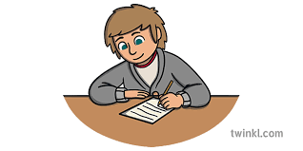
Conclusion
The assignment has been illuminating for me, at the core of the learning labs and reading is the ability to use service design as a means to transform services through changing the user experience. The learning for me has been that the tools discussed (and others) can be used to make services better and more in touch with the service user. It can demonstrate how we reached decisions which means accountability and the ability to review and change in a systematic and structured way.
IThe output od the project was the development of a new service user feedback form which more accurately captures service user feedback.
The number of service users who have completed the form has increased and the information gathered. Our outcomes are yet to be accurately accessed as we are collating information and developing action plans on a quarterly basis.
It is hoped that more useful information will allow us to maintain and develop better services.
We required by our regulatory body to collect service user feedback, but this needs to be a meaningful. Given the nature of and the changes within the service user, cohort we known that we need to change our methods of feedback regularly to encourage on-going participation. We will rerun this process in a year’s time, to ensure there isa freshness to the feedback process.

Slide 110
Summary of process
Empathy mapping
We started the project with empathy mapping which allowed us to find out about those who will use the feedback process.
We created personas to define the problem by using information found within the empathy mapping through personas
“Personas are fictional characterisations drawn from research data. They are not preconceived stereotypes; they are archetypes borne of careful study” (Luma Institute, 2012)
ABC avalanche
By the point, we will have identified the problem and are now looking at developing a solution. ABC avalanche was one of the methods to generate ideas.
Prototyping
Prototyping allowed us to distil the concepts and ideas we have produced and test it, to finesse and finalise.
Personas

Slide 111
Bibliography
Arnold. K, (2021) Refugee integration loans: a Policy CoLab case study. https://hodigital.blog.gov.uk/2021/12/21/refugee-integration-loans-a-policy-colab-case-study/
Byttebier, I. & Vullings, R. (2007) Creativity today: Tools for a Creative Attitude. BIS Publishers B.V
Dam, R. F. and Teo, Y. S. (2024, February 8). Personas – A Simple Introduction. Interaction Design Foundation - IxDF. https://www.interaction-design.org/literature/article/personas-why-and-how-you-should-use-them
Design Council (2024) The Double Diamond - Design Council. https://www.designcouncil.org.uk/our-resources/the-double-diamond/
Downe, L. (2020) Good services: Decoding the Mystery of What Makes a Good Service. BIS Publishers.
Gibbons, S. (2024) Journey Mapping 101. https://www.nngroup.com/articles/journey-mapping-101/
Griffith Centre for Systems Innovation et al. (2024) Problem Framing Canvas, https://www.griffith.edu.au/__data/assets/pdf_file/0025/1750570/Problem-Framing-Canvas-Handbook.pdf

Slide 112
Bibliography
IDEO U (2024). https://www.ideou.com/en-gb/pages/design-thinking
Luma Institute, (2012). Innovating for people: Handbook of Human-Centered Design Methods. Luma Institute
Miller & Flowers (2016) The difference between a journey map and a service blueprint. https://blog.practicalservicedesign.com/the-difference-between-a-journey-map-and-a-service-blueprint-31a6e24c4a6c
Morales D. (2017) What is Service Design A tale of two coffee shops. https://www.youtube.com/watch?v=HNOY8GLVy_8.
Pybus, J. (2021) 'Service Design Case Study: Redesigning the Future of Public transport,' Medium, 10 December. https://medium.com/swlh/service-design-case-study-redesigning-the-future-of-public-transport-7454275abfa1.
Osterwalder, A. & Pigneur, Y. (2010) Business model generation: A Handbook for Visionaries, Game Changers, and Challengers. John Wiley & Sons.
Stickdorn, M. et al. (2018) This is service design doing: Applying Service Design Thinking in the Real World: A Practitioners’ Handbook. O’Reilly Media.
Stickdorn, M. & Schneider, J. (2012) This is Service Design Thinking: Basics, Tools, Cases. BIS Publishers.

Slide 113
Social Inequalities Conference
Wednesday 25 September 2024
Lunch 12.15-1pm

Slide 115
Let me tAke you back…
Let me introduce you to myself in my most innocent form. When things were easy.
Only if things were still blissfully innocent!
Look at that face…such a cute child.
I know you’re thinking it – what happened?!

Slide 116
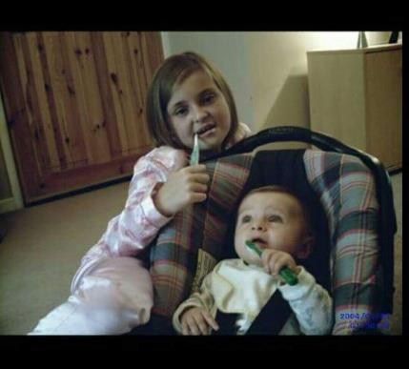
Our family is growing and my innocence is dwindling!
The baby boy arrives. We welcomed the sweetest addition to the family.
A lovely family photo hiding the brutality of drug addiction.
A lovely family photo hiding a 10 year old girl with every ounce of innocence shattered.
But love glueing us together.

Slide 117
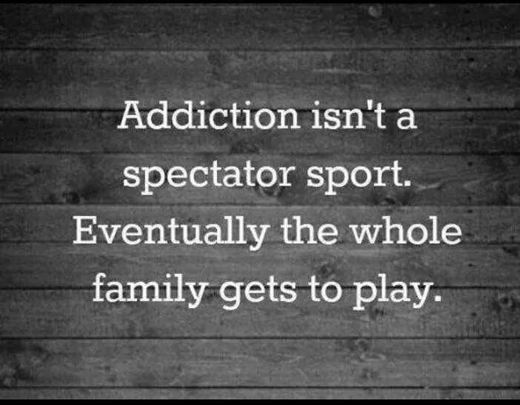
The Camerons crumble…(kinship care)
HEARTBREAK
DEVASTATED
LOST
DISBELIEF
ASHAMED

Slide 118
An open letter that opened doors - the power of social media!
Why an open letter and why now?
CHALLENGE STIGMA

Slide 119
YOUNG SCOT AWARDS

Slide 120
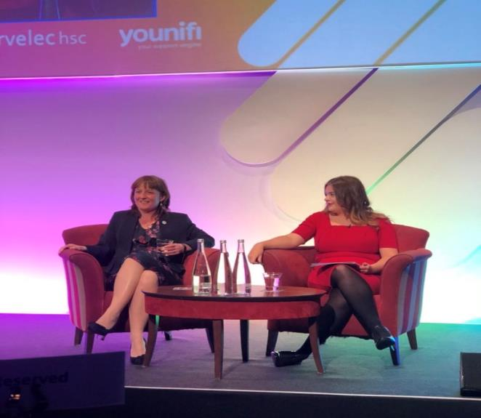
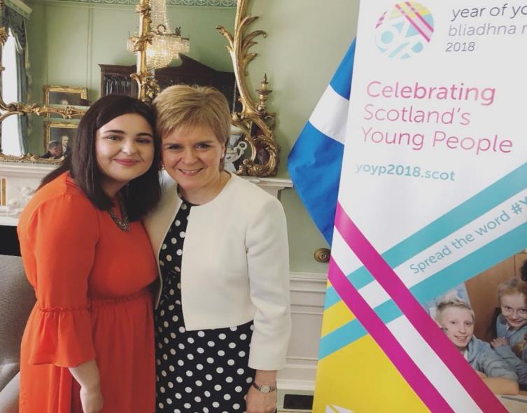
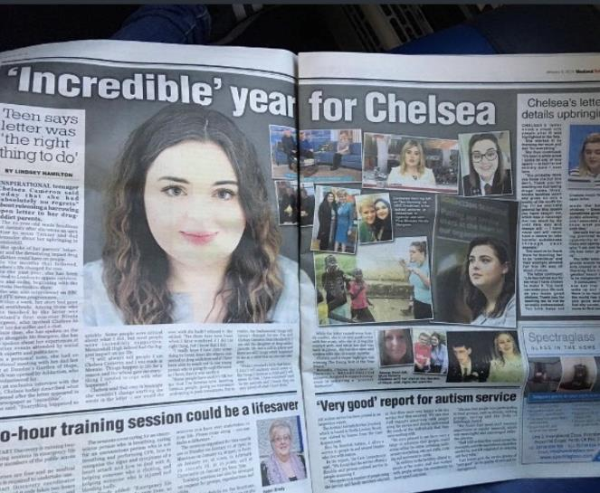
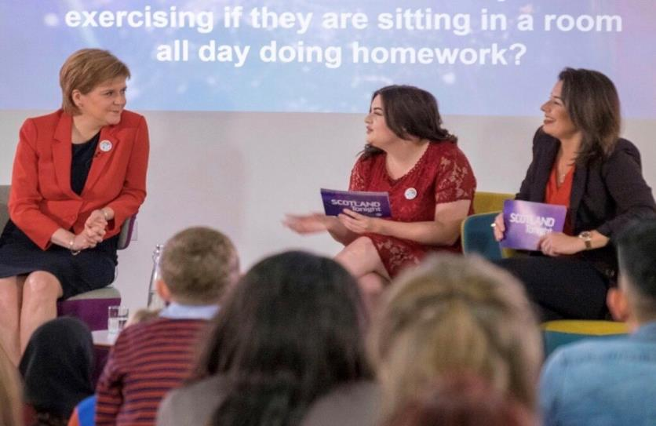
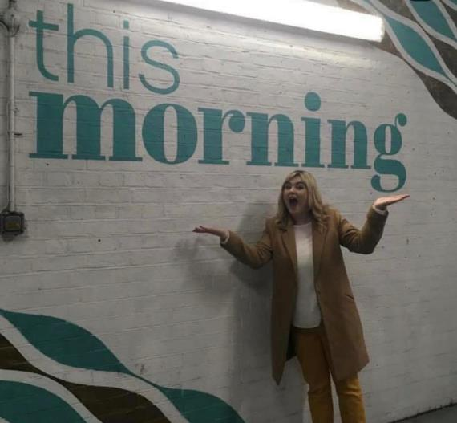

Slide 121
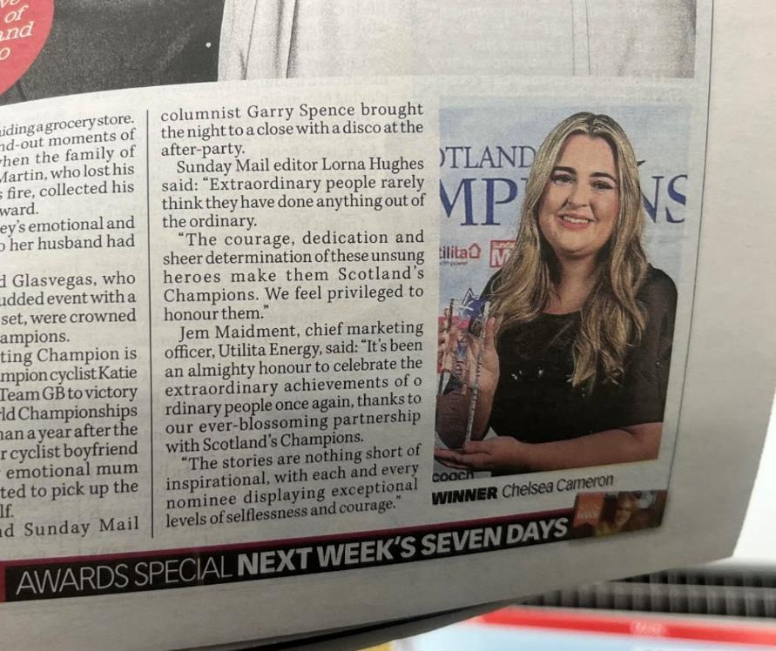
WHAt Now? Community Champion of Scotland 2023

Slide 122
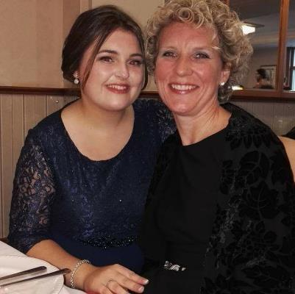
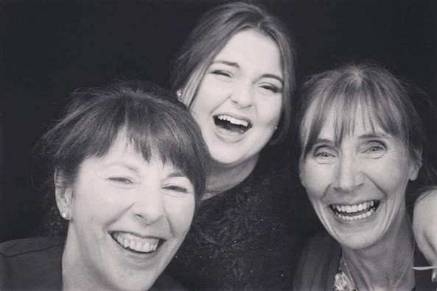
Everyone needs a “silent cheerleader”.
FIND A CHEERLEADER OR BE A CHEERLEADER

Slide 123
My message to you – first a person then a professional
NON JUDGEMENTAL PROFESSIONAL APPROACH
SHOW EMPATHY – SEE THE PERSON BEFORE THE PROBLEM
DON’T FEED INTO THE STIGMA NARRATIVE
DON’T DEFINE ANYONE BY THEIR CIRCUMSTANCES

Slide 124
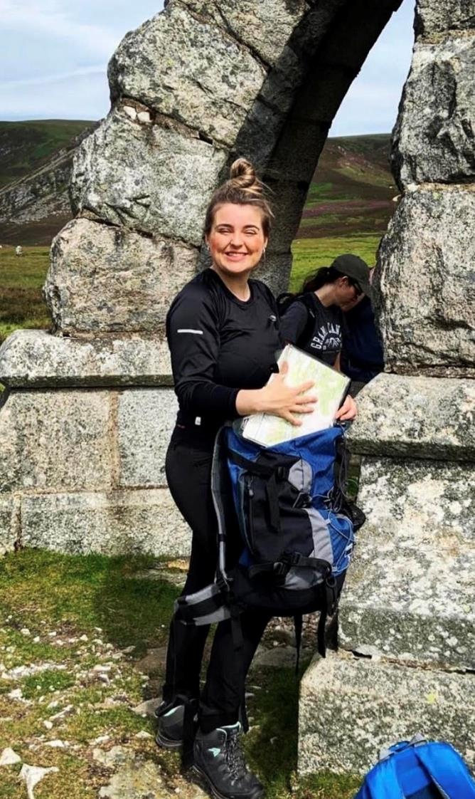
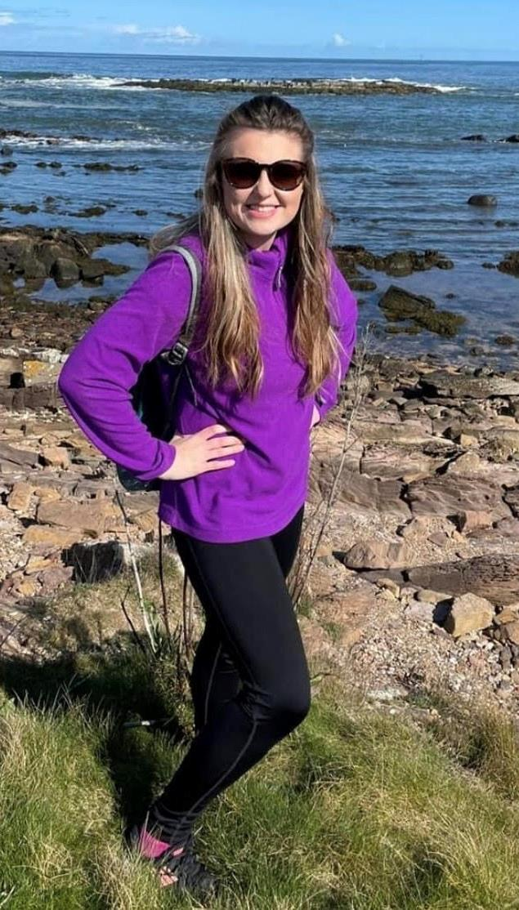
LIFE IS NOT SUNSHINE AND RAINBOWS BUT LET’S FIND JOY IN THE JOURNEY
Personal challenges overwhelm each and everyone of us but let’s find a reason to smile and let that rub off on others.

Slide 125
Social Inequalities Conference
Wednesday 25 September 2024
Councillor Lynne Short: Inequality in Dundee

Slide 126
THE SOCIAL REPRODUCTION OF INEQUALITY
Professor Alex Law
Abertay University

Slide 127
Why are inequalities worsening over time?
Advantages and disadvantages passed on across the generations despite the widening of educational opportunities
Social suffering of men and women, young and old, working class and middle class, immigrants and residents
Austerity since 2008 disproportionately punished the poor
Compounded by the pandemic
Housing and neighbourhood stigmatisation of ‘outsiders’ Isolation, disability and mental health crisis

Slide 128
Punishing the poor
In 2020-23 the top 10% of the population had 34% more income (before housing costs) than the bottom 40% combined.
(Scottish Government income equality statistics)
10% of the wealthiest households typically own £1.7 million in total wealth, compared to £7,600 in the least wealthy 10% of households. (Scottish Government wealth statistics)
Men in the most deprived areas of Scotland live 26 years less and almost 25 years less for women than the least deprived areas.
(National Records of Scotland)

Slide 129
Perpetuating social suffering
Disadvantaged youth face a stressful and precarious world of uncertainty about the future
School raises aspirations that can conflict with lived realities at home, online and on the street
Social suffering is all the more painful when people are made to feel that
their low standing is a result of personal failings not the underlying conditions of social disadvantage
Social suffering (relative poverty) is often relegated well below material
suffering (absolute poverty)

Slide 130
Danny Dorling
Seven Children: Inequality and Britain’s Next Generation
(forthcoming book, 26 September 2024)
Poorest children in the UK are physically smaller and hungrier today than 10 years ago Poorest fifth of households in Britain are worse off than the poorest fifth in most of Eastern Europe
6% of the children in best-off families each year receive and spend 33% of all the income in the UK
In 2024 a few children use up far more resources than the vast majority of other children,
such as many more schoolteachers per child, better food, better shelter, more warmth, more toys, better material everything; often more than you might think any child needed.

Slide 131
Can ever more extreme inequalities be reversed?
Break the social reproduction of grossly unequal starting positions Accept that these are not the ‘natural’ outcome of markets or individual abilities
Redistribute socially-produced resources more equitably
Massive reinvestment in public welfare, education, housing, social care, health and social security
Widen learning chances for well-funded school, higher and further education
Enable students to acquire what is culturally valued, formal qualifications and personal development

Slide 132
UNLOCK YOUR POTENTIAL
Scan to find out more

Slide 133
Unemployment
Robbie Timmons
Performance Manager
Social Inequalities Conference
25th September 2024

Slide 134
2,500 employees; Over 13,000 people supported;
2,200 employees
Over 1,100 people supported to live independently
2.5m hours of social care support 27 local authority areas
Sector-leading CI grades
30 employees
12,000 members across 32 local authority areas
Charitable projects supporting 3,000 people per year
30 local branches supporting 2,000 people
150 employees
5500 people supported across 28 local authority areas per year
1000 disabled people supported into work
Over 2,000 employers supported to be inclusive
Notes:
To begin with I will start with some background information regarding Enable, In 1954, five sets of parents of children who had learning disabilities met in Glasgow to share their experiences and support each other to challenge society’s attitudes towards learning disability. Those parents reached out to more parents, and the charity which became Enable was born.
One key fact that is important to recognise is that it wasn’t until the 1970’s that institutionalisation of children with disabilities declined and the 1981 education act played a key role in promoting the integration of children with disabilities into mainstream schools.
Enable has since grown into 3 pillars,
Enable Cares – focusing on the delivery of Social Care across Scotland supporting over 1100 people to live independently, achieving sector leading Care Inspectorate Grades for the care delivered
Enable Communities – who directly supports more than 3,000 people all over the country to:
be local activists, get specialist information, advice and advocacy, access community-based support across a growing network of 72 local groups and, lead campaigns for change
And Finally Enable Works

Slide 135
Enable Works
We support
We support
5,500 people
1,000 people
Across 28 Local Authorities in Scotland
into work each year
We partner with thousands of employers to create inclusive cultures and improve the diversity of Scotland’s workforce
We challenge perceptions of disability and unleash the potential in Scotland’s workforce.
Notes:
We believe that every person in Scotland has the right to work in a job that is high quality and well paid.
Enable Works supports over 5500 people every year across 28 Scottish Local Authorities to learn skills for work and we support more than 1000 people into work each year.
We partner with thousands of employers to create inclusive cultures and improve the diversity of Scotland’s workforce.
Together we will challenge perceptions of disability and unleash the potential in Scotland's future workforce.

Slide 136
Current Unemployment Stats
The current unemployment rate for people aged 16 and over in the UK
It is estimated that
1,430,000 people¹
4.2%¹
Are currently unemployed in the UK
The current unemployment rate for people aged 16 and over in Scotland
It is estimated that
109,000 people²
3.8%²
Are currently unemployed in Scotland
1 https://www.ons.gov.uk
2 https://gov.scot

Slide 137
Why are we needed?
It is estimated that
4% of school leavers²
1,520,000 adults¹
who have a learning disability go into university , compared with
have a disability or long-term health condition in Scotland
45% of all school leavers²
There is a significant disability employment gap
For every £1 a non disabled person makes,
a disabled person earns just
50.7% of disabled people²
are in employment in Scotland, compared with
earns just 86.2p³
82.5% of non-disabled people²
1 https://www.scotpho.org.uk
2 https://www.gov.scot
3 https://www.ons.gov.uk
Notes:
Why are organisations like Enable Work required
It is estimated that 1.52 million or 35% of the current adult population in Scotland have a disability or long-term health condition, This includes a wide range of conditions that can impact daily activities and overall well-being.
This shows a high inequality of those with learning disabilities moving into university level education which severely impacts their learning and skill development opportunity
This means there are over 820,000 people in Scotland with a disability or health condition not currently employed
This means a disabled person works free for 51 days a year in terms of earnings.

Slide 138
Why are we needed?
Youth unemployment rate is currently
30% of care experienced²
14.2%¹ which is 3x higher¹
school leavers are unemployed nine months after leaving school in comparison to
than the current UK unemployment rate
8% of non care experienced²
3 in 10 children³
1 in 5 people³
live in poverty in the UK
live in poverty in the UK
4.3 million children³
14.4 million people³
all in
dundee
1 https://www.ons.gov.uk
2 https://www.iriss.org.uk
3 https://www.jrf.gov.uk

Slide 139
How do we tackle these inequalities?
Policy and Strategy
Policy and Strategy
Strategy and Action Plans

Slide 140
all in
dundee

Slide 141
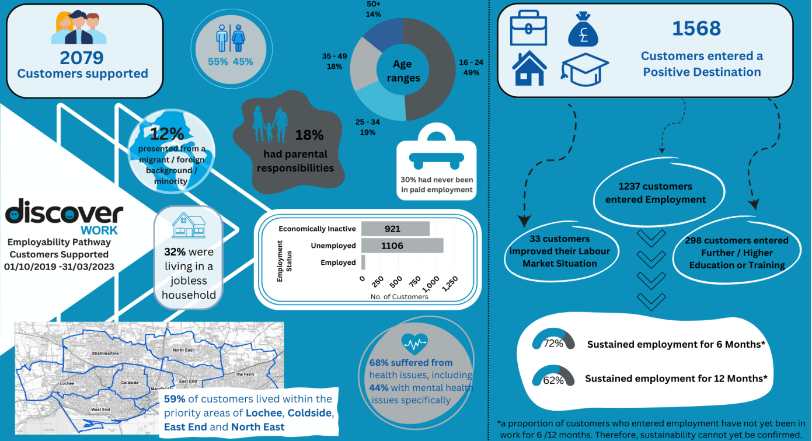

Slide 142
Thank you
@Enable_Tweets
/enablescotland
/enablefacebook
@enable_updates

Slide 143
“The benefits system as a cause of poverty”
We provide a nutritionally balanced three day emergency food parcel provided for local people in need.
What is need? Anyone who is going though a hardship, crisis or difficulty and finding themselves in poverty by not affording the basic essentials.
They can be:-
a university or college student,
someone who is unemployed,
someone who is in employment suffering from in-work poverty on a zero hour contract,
even pensioners.

Slide 144
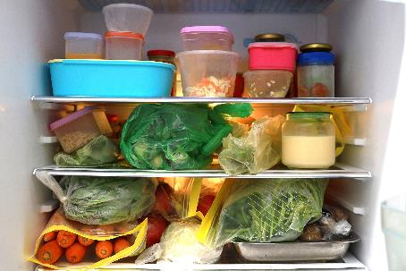
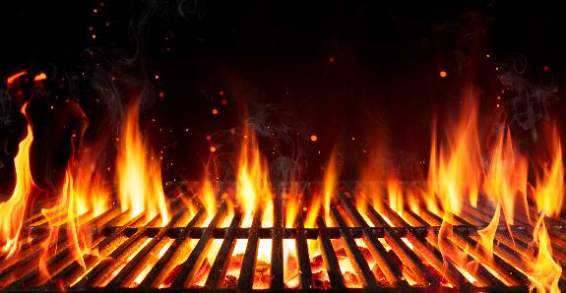
Main causes of poverty
Cost of living – food, gas & electricity. Poor housing. Drug & alcohol abuse.

Slide 145
What is the problem with the benefit system?
Lack of knowledge
What are you actually entitled to?
Universal Credit a single person under 25 years of age is £311.68 per month
Teenagers 16 or 17 years with a disability
or who has a child
or is a carer

Slide 146
How does the benefit system cause poverty?
Simple. By not putting enough money in people’s pockets.
On 7th Novemeber 2022 the British government gave out the first Cost of Living payments to all people who were receiving benefits.
On 14th November 2022 the Scottish Child Payment Benefit began of which over 90% of those entitled have taken the payments of £26 per week per child.
Dundee & Angus Foodbank saw a decline of over 40% of people needing a food parcel that month

Slide 147
How do we reduce the poverty levels?
Increase the amount given for Universal Credit
Increase the amount given for the Scottish Child Payment Benefit to £40 per week per child
Improve housing which will improve health
Lower the cost of gas and electricity
Put more money in people’s pockets!!

Slide 148
Family Structure as a Cause of Poverty: Focus on Single Parents in Scotland
Sarah Stewart
Head of Service for Support for Families
September 2024

Slide 149
About One Parent Families Scotland
Established in 1944 - 80th anniversary year!
Providing expert advice and practical support to single parent families across Scotland.
Campaigning with parents to make their voices heard to change the systems, policies and attitudes that disadvantage single parent families.

Slide 150
Our vision and mission
Our vision is of a Scotland where single parent families are celebrated in all their diversity, are treated fairly and live free from discrimination and poverty.
Our mission is to amplify the voices of single parents in their unique role as sole carers and providers and together challenge stigma, poverty and inequality to achieve change.

Slide 151
Single parents in Scotland
144,000 single parent families in Scotland
1 in 4 families in Scotland are
Single Parent Families.
80% of single parents are aged between 25 and 50
65% with dependent children
are in paid employment
Less than 1% are under 20

Slide 152
Children in single parent families
4 out of 10 children in poverty live in a single
parent household.
Two thirds of these children live in single
parent households where no one is in paid work
A quarter (23%) live in families where the parent works part-time.
·
·
40% of children in a single parent
household are also in a household with a
disabled person

Slide 153
Overview of Poverty
Poverty: “When a person’s resources are not enough to meet their basic needs and allow them to take part in society. This could mean struggling to cover food and energy bills, watching every penny spent, worrying that nothing is set aside for a sudden emergency such as the cooker breaking down, or being unable to afford the cost of transport needed to visit a friend or go to a social club.”
Age UK 2015

Slide 154
Family Structure
Family Structure as a Factor in Poverty:
Family structure plays a significant role in poverty levels in Scotland. Certain family types are more vulnerable to poverty due to various structural and socio-economic factors. :
Lone Parent Families
Minority Ethnic Families
Families with Disabled Members:
Young Parents:.
Larger Families
Families with Young Children.
Notes:
Lone Parent Family structure plays a significant role in poverty levels in Scotland. Certain family types are more vulnerable to poverty due to various structural and socio-economic factors. Here are some key points:
Lone Parent Families: These families are at a higher risk of poverty. The challenges of single-handedly managing childcare and work can limit income opportunities¹.
Minority Ethnic Families: These families often face additional barriers such as discrimination and limited access to resources, which can contribute to higher poverty rates¹.
Families with Disabled Members: Whether it’s a child or an adult with a disability, these families often incur extra costs for care and support, which can strain their financial resources¹.
Young Mothers: Families with mothers under 25 are more likely to experience poverty. Younger mothers may have less education and work experience, impacting their earning potential¹.
Large Families: Families with three or more children face higher living costs, which can increase their risk of poverty¹.
Families with Young Children: Families with children under one year old often have reduced income due to parental leave and increased expenses for childcare¹.
Addressing poverty in Scotland requires a holistic approach that considers these diverse family structures and the unique challenges they face¹².

Slide 155
Single Parent Households and Income Disparity
I’m concerned about being able to keep my job as I can’t afford childcare anymore and I’m struggling to work flexibly as my job requires.
Notes:
Single parents Typically earn less than their dual parent counter parts – due to limited time and flexibility for work, Lower paid jobs due to lower education levels and fewer opportunities. Gender impact: majority of single parents are women who face a gender pay gap.

Slide 156
Additional Challenges
Childcare Costs & Caring responsibilities
Housing Instability
Social Isolation
Mental Health Impact
Stigma and shame
Notes:
Childcare: Difficulty in affordable and flexible childcare – can lead to under employed or unemployed. School holidays – current free childcare amounts to around 30 hours per week during term time. Housing Instability: insecurity, frequent moves and living in substandard conditions. Lack of stable housing – many council have declared a housing emergency. affect children's well being and parents ability to maintain employment. Social isolation: access to services, cost of living and limited access to affordable support systems. Impacting on mental health leading to stress, anxiety and depression. Stigma – despite 1in 4 families in Scotland and 42% of marriages end in divorce there is still a lot of societal prejudice exist – stereotyping – seen as irresponsible or reliant on benefits, discrimination and

Slide 157
Cost of Living
…the choices I make daily are getting harder…weeks we rely on food donations and surplus food at reduced prices. Not ideal for someone in full time employment.
SINGLE PARENT

Slide 158
Policy Responses in Scotland
Scottish Child Payment
Best Start Grant and Best Start Foods
Free Childcare
Parental Employability Support Fund

Slide 159
Conclusions
Single parents face unique challenges
- Policy initiatives are a step in the right direction, but more is needed.
CALL TO ACTION: Encourage policy makers, community leaders and you as citizens to focus on improving the conditions of single parent households to reduce poverty and stigma.

Slide 160
Visit our
website
Use our free helpline
& live chat service
Stay in touch!
Follow us on
social media @opfs
Sign up to our
newsletter

Slide 161
Poverty and Gender-Based Violence (GBV)
Emma HOSKINS
Gender based Violence Learning and Development officer - Women’s Rape and Sexual Abuse Centre/ Dundee City Council
DANIELLE WYLIE
PREVENTION WORKER - DUNDEE WOMEN’S AID
Notes:
Introduce selves
Emma - Intro
Here today to you about links between Poverty, Gender and Gender Based Violence
I will begin with a very brief introduction outlining what GBV is and looking at the picture Global to Local. I have previously presented and looked at this issue using a PESTLE framework to examine the links using as much data and evidence as I can from a Scottish prospective specifically, and where we through the work we do at WRASAC and Womens Aid - this is a he subject
D - Health warning

Slide 162
Gender-Based Violence (GBV) / Violence Against Women and Girls (VAWG)
GBV refers to harmful acts directed at an individual based on their gender or violence that affects persons of a particular gender disproportionately.
Notes:
Emma

Slide 163
GBV - Global
1 in 3 Women worldwide will experience violence in their lifetime, most likely at the hands of someone they know
5 Women are killed every hour by their partner or family member
15 million girls are married before the age of 18, every year
Violence against women and girls is a global problem, but women and girls living in poverty are even more at risk.
Why ActionAid is ending violence against women and girls - YouTube
Notes:
Emma
Gender Based Violence Definition GBV is violence directed to any person based on tier sex, gender identity, stereotypes, gender inequality and perceived gender roles in society
Source - Action Aid
Footnotes
1World Health Organisation, Violence against women, intimate partner and sexual violence against women: http://www.who.int/mediacentre/factsheets/fs239/en/
2ActionAid (2016) Fearless: Fearless women and girls leading the way, transforming lives: https://www.actionaid.org.uk/sites/default/files/publications/fearless_women_and_girls_- _leading_the_way_transforming_lives.pdf/
3WHO: Adolescent pregnancy: https://www.who.int/news-room/fact-sheets/detail/adolescent-pregnancy ↩
Poverty and Economic inequality increase a women's risk of being subject to violence, it can undermind her voice and bargaining power at home and in wider society
VAWG is a
Often, survivors can’t get medical support because they can’t afford it or because they are too far away from a hospital.
Many can’t or don’t want to go to the police, sometimes due to fear of retribution or because of an acceptance of violence in their society.
Girls may drop out of school and end up being forced to marry early. Many are left dealing with the emotional and physical impacts of the abuse on their own.
5 links between poverty and violence against women | ActionAid UK

Slide 164
GBV - Global
1. Violence squanders women’s life-opportunities
2. Poor women have less opportunity to flee
3. Violence keeps women and girls poor
4. Poor women are at higher risk of sexual exploitation and trafficking
5. Violence has huge social and economic costs
Violence against women and girls is a global problem, but women and girls living in poverty are even more at risk.
Notes:
Emma
Gender Based Violence Definition GBV is violence directed to any person based on tier sex, gender identity, stereotypes, gender inequality and perceived gender roles in society
Source - Action Aid identified that there are 5 key clear links between poverty and GBV/VAWG
Effects performance /attendance at school and work – impact on their opportunities for further education, better employment or even the ability to access employment at all. Ability to defend your rights, money you can earn, education about what is safe and acceptable in relationships. IN the home more and not able to see others access services
Access to money greatly restricts freedoms and ability to leave -
Behavior controlled, ability to leave physical and psych impact holds/traps women. If every day you are experiecing DA the toll and the impact this takes is huge – women are surviving not actualizing
Women and Girls make up 96% of traffiking for sexual exploitation. If you don’t have control of your own body and it is being used to ak money for others. Traffiking and debt bondage. Never able to work off debt
These can be direct costs for policing, courts and health care or indirect costs from lost opportunities through girls missing education and women having to take time off work or even losing their jobs.Violence against women and girls results in lasting physical and psychological damage affecting women world-wide
5 links between poverty and violence against women | ActionAid UK

Slide 165
GBV – Local
Sexual Violence
The number of sexual crimes recorded by the police In Scotland in 22/23 – 14,834
In 2022 - 2023 there were:
2,567 crimes of rape and attempted rape recorded by Police Scotland.
37% of recorded rape and attempted rape involved a victim under the age of 18 (2022-23).
5,237 crimes of sexual assault recorded by Police Scotland.
Domestic Abuse
In 2022-2023, there were 61,934 domestic abuse incidents recorded by Police Scotland. Around four out of every five of these incidents (81%) had a female victim and a male accused.
Of these incidents,1,753 were recorded as crimes under the Domestic Abuse (Scotland) 2018 Act. 95% (1,668) of the DASA charges reported were in cases where the accused was male.
Notes:
E first bit
D last it
SV
If we look at this in terms of Scotland stats for DA and SV a
(Source: Sexual Crimes - Recorded Crime in Scotland, 2023-24 - gov.scot (www.gov.scot))
Sexual crimes from 1971 onwards have been on a long-term upward trend since that point, with some fluctuations. Levels are now at the third highest seen since 1971. The national rate of recorded Sexual crimes was 27 crimes per 10,000 population in 2023-24, unchanged from 2022-23.
The actual figures are higher than these statistics suggest due to low reporting of these crimes.
Sexual crime has increased significantly since 2010-11 despite a small decrease in the latest year.
Chart 8: Sexual crimes recorded by the police, 1971 to 1994, 1995‑96 to 2023-24. Number of recorded Sexual crimes, 000s. If you follow the link there is a table/chart on this page that shows this.
Scottish Crime and Justice Survey 2019 - 2020 showed that only 22% of victims/survivors of rape reported it to the police. (Source) No update can be found for this in 21/22 survey.
DA
However, we know most incidents of domestic abuse go unreported to the police.
The 2018/20 Scottish Crime and Justice Survey found that just under a sixth (16%) of those who experienced partner abuse in the 12 months prior to interview said that the police came to know about the most recent (or only) incident.(Source)
EXTRA Euorpean Stats
› 1 in 5 women experience domestic violence over their lifetimes. › Between 6–10% of women suffer domestic violence in a given year.3 › It accounts for between 16% and one quarter of all recorded violence with one incident reported to the police every minute. › In any one year, there are 13 million separate incidents of physical violence or threats of violence against women from partners or former partners. › 2 women a week are killed by a male partner or former partner. ChangingLivesPamphlet.pdf (womensaid.scot)
domestic-abuse-publication-2022-23-final-1.pdf (copfs.gov.uk) - DASA

Slide 166
Gender and Poverty - Local
In Scotland, women more likely than men to be in poverty, to experience in-work poverty and to experience persistent poverty.
Women more likely to be in low paid, insecure work – 62% of those earning less than the real living wage are women
Women more likely to be reliant on social security system
Women more affected by household debt and have fewer savings
61% of women surveyed reported they were in debt because of financial abuse.
Notes:
D
As women are main recipients of benefits, they have been impacted by austerity more– two main reasons: more likely to be in situations which they have to claim benefits for (e.g. single parents) and more likely to act as ‘conduits’ i.e. receive benefits on behalf of others (e.g. children)
Engender – impact of benefits and cuts
Womens Services have also experienced austerity cuts and as public services have been cut and front line workers and services reduced third sector womens/gbv services are plugging gaps and yet are not main stream funded. Also these services which are prondinatky staffed by women face roll over budgets for the past 3 years with no option to increase wages/give pay rises to tackle cost of living.
The House of Commons Library estimates that, up to the 2017 autumn budget, 86% of the reduction in public spending which the government has made through changes to taxes and benefits is from spending which previously went to women.
In 2018, 1/6 individuals in the UK are overindebted (approx. 8.2 million people). 55% female, 58% have children and overall more likely to be young and live in private lets.
Debt figures
This shows the clear link between poverty, gender and GBV
Poverty disproportionately impacts women - we need solutions | Rape Crisis Scotland
committees.parliament.uk/writtenevidence/126340/pdf/

Slide 167
How might finances be used to abuse someone?
Notes:
D

Slide 168
Notes:
D

Slide 169
Restriction
Has complete control over all financial and economic resources
Makes important financial decisions without discussion
Controls the use of property (mobiles, housing, transport etc)
Makes partner ask/beg for money
Demands receipts to be shown, change to be given etc
Exploitation
Does not pay bills or pays late
Spends money needed for essentials
Builds up debt under partner's name
Steals money or property
Refuses to contribute
Sabotage
Does things to stop victim-survivor going to work/college/university
Does not allow partner to work/study
Refuses access to bank accounts / cards
Interferes with benefits / claims
Takes money away from children
Notes:
D
Safe and Together

Slide 170
Financial abuse
97% of women who experience domestic abuse will experience some form of financial abuse
89% of women who were in abusive relationship, and employed, experienced their abusive partner turning up to work, or making her late to work, in order to undermine her.
87% of women surveyed experienced financial exploitation e.g. taking debt on in her name only
Data shows that the biggest barrier to leave an abusive relationship is financial dependency on the perpetrator – this is often by design of the perpetrator, and will include coercive control, financial abuse and reproductive control (coercing the female partner into having more children, either by rape or controlling birth control).
Notes:
D

Slide 171
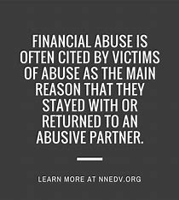
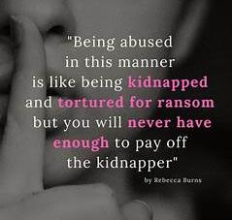
Abusers Create Poverty-
Notes:
D

Slide 172
Multiple Pathways to Harm
Children’s Trauma & Safety
Victim of abuse and harm
Seeing, hearing or learning about the abuse
Effects on Family Ecology
Loss of income
Housing Instability
Loss of contact with family
Educational and social disruptions
Harm to child
Behavioural, emotional, social, educational
Developmental
Physical Injury
Perpetrator’s Pattern
Coercive control towards adult survivor
Actions taken to harm children
Effect on Survivor Parenting
Depression, PTSD, anxiety, substance use
Loss of authority
Energy goes to addressing perpetrator instead of children
Interference with day to day routine and basic care
Notes:
D- Holding perp to account
Moving away from victim-blaming

Slide 173
Sexual Violence and Commercial Sexual Exploitation
Sexual Violence often impacts a person's personal and economic wellbeing
Living in poverty, where basic needs such as food /shelter are not met or at risk of poverty/low/limited income increases risk of sexual exploitation and violence occurring
CSE/Sex Work presented as an option to women who are in poverty – sex for rent/ only fans - “easy way to make money” but is it?
High levels of physical and sexual violence
High levels of trauma, poor mental health
High levels of substance use as a way to cope
Notes:
Emma
– interrupts work/education, impact on individuals wellbeing and mental health , lots of people don’t tell anyone so cant access support in conventional ways and therefore impact can worsen over time as not addressed.
Impact of court case and resource - attending and travel etc time off from work for surviros
- vulnerability/access to money /
- Reference to only fans and
Increase in perps exploiting and CSE and links to that
There is no fixed definition of commercial sexual exploitation (CSE), but a useful definition is:
“Sexual exploitation is a practice by which person(s) achieve sexual gratification, or financial gain, or advancement through the abuse of a person’s sexuality by abrogating that person’s human right to dignity, equality, autonomy, and physical and mental well-being.”
Examples of CSE: on/off street prostitution, webcamming, porn, phone sex, stripping, lap dancing and trafficking.
Work or Gender-Based Violence?
We believe that CSE is a form of Violence Against Women and Girls – this view is shared by both the Scottish Government and the United Nations.

Slide 174
Childhood Sexual Abuse (CSA)
Adults who experience maltreatment in childhood, including sexual abuse, are twice as likely to fall below the poverty line
Female survivors of CSA are more likely to experience unemployment and lower educational attainment than their male counterparts
This means that services who are working with those in poverty have an increased likelihood of working with adult CSA survivors.
Women who are accessing services around education and employment may have additional barriers related to CSA
Notes:
Emma
CSA trauma can present itself in complex ways, and it’s important services and professionals have good understanding of this. This is part of being trauma informed, but is merging a clear understanding about sexual abuse and trauma.

Slide 175
Other Contributing Factors
Data shows that lower socio-economic households are 3.5 times more likely to experience domestic abuse than those in higher income households.
Reasons for this are complex, and stereotyping should be avoided, however those living in poverty tend to experience more risk factors and fewer protective factor related to GBV. Including substance misuse, living in areas of high crime rates, housing insecurity, food insecurity, debt, unemployment/under employment.
Poverty also increases length of time a survivor is in the violent relationship/situation as they will have far fewer resources to leave
Notes:
Emma
- GBV is an indiscriminate form of violence and terror that all groups and members of society may experience, however we know some groups are at greater risk and will experience this violence in specific forms. Women are the most the obvious group who face greater risk, but we can break this down further.
- All of these can be stress factors on a household/relationship, and those under greater stress may react violently.
– this is both financial but also cultural capital e.g. being able to understand and navigate the complex welfare/legal system.

Slide 176
Other Contributing Factors Homelessness
Housing and homelessness is an area where the link between GBV and poverty is very clear. Due to the lack of financial independence many woman face, they will be unable to make safe housing options for themselves and are at risk of greater exploitation in order to seek shelter.
Whilst more men are homeless overall, the primary reason for female homelessness is a direct result of interpersonal violence.
Women may face increased risk of Cuckooing due to their vulnerability related to poverty, substance misuse and their gender.
CSE does not always have to have money involved, but instead sex for shelter has become increasingly common with rent increases, low housing stock and now the increased cost of living.
Those women who are in a stable tenancy, may have experienced sexual or domestic violence in their home, and feel unable to leave their secure housing. Sacrificing mental health for housing.
Notes:
Emma

Slide 177
Other Contributing Factors Intersectional Discrimination
Black, Asian & Minority Ethnic (BAME) women more likely to experience poverty and GBV resulting in ‘intersectional discrimination’
These women will be dealing with poverty, racism/xenophobia, GBV and misogyny
Some of this will be felt from their community, but the reality is some of this will be felt from services, institutions and legislation.
Intersection of increased risk factors for certain groups (language/cultural differences, isolation, small communities, lack of English literacy, lack of system knowledge etc) and structural barriers (no recourse to public funds, insecure immigration status).
In 2015/16, 50% of Bangladeshi, 40% of Black African/Caribbean and 46% of Pakistani households were in poverty, compared with 19% of White British households (UK wide)
Notes:
Danielle

Slide 178
Summary Poverty and GBV
Poverty and gender based violence are intrinsically linked, and in complex, far reaching ways.
Poverty impacts both perpetration and victimhood, as well as barriers to leave violence
Whilst gender based violence can impact all people in society, women in poverty are a group at much greater risk, and will experience specific risks and challenges related to GBV and accessing services
Notes:
Emma/Danielle
Explain about other slides

Slide 179
ADDITIONAL SLIDES AND INFORMATION
SLIDES AFTER THIS POINT WERE NOT USED IN THE PRESENTATION BUT HAVE BEEN LEFT IN AS THERE MAY BE USEFUL INFORMATION FOR STUDENTS IN

Slide 180
Dundee demographics
Dundee City has second lowest male life expectancy in Scotland (73.92 years) and fourth lowest female life expectancy (79.48 years)
36.6% of Dundee population lives in the cities most deprived areas, with 43.8% of children in Dundee living in these areas.
Single parent households count for 6% of Dundee households (higher than national average) – across UK 90% of SPH are headed by women).
30.1% of children in Dundee live in families that experience both low income and material deprivation – national average is 20.7%
23% of Dundee City housing stock is private rental property, second highest in Scotland behind Edinburgh at 25%.
Dundee has highest domestic abuse rate in Scotland

Slide 181
Angus Demographics
Angus child poverty rate 21% 2020-2021 - Joseph Rowntree foundation
Sex crimes in Angus increased by 18.9% from 20/21 -22/23 - Angus Council Scrutiny and Audit committee report by Police Scotland
There is a significant increase in the number of reported sexual crime in Angus (by 49 crimes) in comparison to last year, and also in comparison to the 5 year average. There is also an increase in the number of recorded crime for rape and attempted rape (by 20 crimes) compared to last year, and also in comparison to the 5 year average. This increase in the level of recorded crime continues the upward trend that we have seen in previous years -Angus Council Scrutiny and Audit committee report by Police Scotland
In comparison to Dundee Angus is below the Scottish National average of 118 - Angus sits at 107 incidents per 10,000 population in 2021-2022 -Scot.gov
64% housing stock is owner occupied with 13% council occupied and 6% housing association- this shows lack of social housing availability
Most deprived 20% for angus cover Arbroath, Brechin, Forfar, Kirriemuir with the lowest ranking being Arbroath (most deprived 5%), Arbroath ranks lowest in Education, health, income and employment - Scottish index of multiple deprivation
Life expectancy for males and females within angus are above average with males 78 years and females 82 years

Slide 182
Dundee City Risk Register (slide written in 2022)
Ukrainian refugee crisis, increased risk of CSE, human trafficking and child exploitation
Over a decade of austerity, compounded by cost of living crisis will leave women facing brunt of economic downturn and financial pressures (this has always been the case in times of recession).
Childcare costs increasing
Creates further barriers for survivors to leave relationships
UK Govt. suggesting increases of child:adult ratio in nurseries, Scottish Govt. may consider similar – would lead to less safeguarding around CSA, amongst many other issues
Fuel crisis
Increased risk of CSE
Increase of financial abuse and finance related abuse

Slide 183
Childcare costs
Domestic abuse can often increase during pregnancy, and after childbirth
Statutory maternity pay, maternity allowance and other maternity related benefits, along with the strict requirements of eligibility, entrap women into being dependent on an abusive partner financially as the weekly/monthly payments would rarely be enough to live on, especially if needing to move to a private let.
This is then further compounded by the cost of childcare – average cost of putting a child into part-time nursery in Scotland has increased to £7000 per year (2022)
Women in abusive relationships may only be offered accommodation outwith their area, meaning they may need to leave their job, move their child from nursery/school or away from family support – this makes it harder for women to leave.
Notes:
This shows very clearly how poverty traps women

Slide 184
Benefits
Universal Credit is paid to the household as standard and is very rarely made into a split payment (despite this being an option by DWP).
Under UC, claimants need to be actively seeking work – those fleeing domestic abuse can have a 12 week break from this. Again, specialist services may need to be involved to ensure this break is in place from the beginning.
In the last 12 months (2022) WRASAC have seen a huge increase in the number of women we support reporting financial difficulties ( 62%)
80% of the women engaged in WRASACs Vice Versa service needed support with money/welfare/benefits.
Notes:
UC on of the most common form of benefits.
Recipients must make an application for this.
In 2018, no woman in Scotland was the recipient of a split UC payment. Something needs saying about universal credit and women – it is discrimination by design | CPAG
Women’s Aid found that 85% of women in abusive relationships believed making an application for split payment would increase the abuse.
Women may need to engage in with specialist services to seek their welfare entitlement safely and as we will go to discuss poverty can further impact on opportunities to do this

Slide 185
Fuel Crisis/Cost of Living Crisis
In March 2022 the Womens Budget Group published a report that evidenced exactly how women will face the brunt of the growing cost of living crisis
Fuel poverty levels in Angus remain static at 20% from 2018/19 - Angus council employability partnership delivery plan
Notes:
WRASAC’s Vice Versa service have seen women constrained into re-engaging with on-street prostitution having been able to leave this for a number of months due to pressure of rising fuel costs
From the extensive literature around domestic abuse we know that methods of coercive control often centre around money. We are likely to see the fuel crisis as a trend in experiences of domestic abuse. For example, women not being allowed access to the car with cost of petrol used as reasoning, women being blamed for increase in utility bills, women having to cut their personal spending (eating, toiletries etc) in order to pay for household
A growing number of women have been pushed into selling sex as a result of the economic impact of Covid 19, whilst the pandemic itself is coming to an end, the long term economic impact is here to stay. This has been compounded by the fuel/cost of living crisis. Women will be at the harsh end of the economic downturn.
English Collective of Prostitutes reported hundreds of women had made enquiries about starting selling sex, or re-engaging in selling sex, since the beginning of Covid 19.
Survey of 222 women, 2/3rds of women engaged in selling sex said they were struggling to feed themselves and needed emergency food vouchers. 3/10 said they were struggling to access Govt. benefits

Slide 186
Technology
Data poverty affects 14% of Scotland’s population
Across Scotland, 88% of the population has access to the internet, this drops to 82% in the poorest parts of the country. Key however, is that 86% of the population mainly access the internet via a mobile phone
Access to benefits, such as Universal Credit, relies on the person having constant access to the internet – this can be an additional stressor as lack internet access can result in missed appointments and sanctions.
Notes:
, – this has big ramifications in terms of being able to access support/information and services. It can also reduce safety for those women who are engaged in selling sex as they cannot keep friends updated about their movements.
meaning access is tied to a singular device, mobile data and expensive contracts/data top ups.

Slide 187
Tech continued
In 22/23 Vice Versa service at WRASAC gave out 19 phones (33 women total accessed VV in this time period), meaning over half of the women in the service needed help getting access to a phone.
In the first 6 months of 2023, 12 phones have been given out across out client base in Dundee and Angus.
For those women fleeing domestic abuse, they may need to get a new phone and contract that is unconnected to the account of their ex partner – this has a financial cost to it
For survivors of sexual violence who report to the police, phones are often taken into evidence.
Notes:
Survivors are then having to pay for a phone contract on a handset they cannot access, phone companies do not take responsibility to replace the handset as it was a police seizure. Survivors often won’t get their device until after trial (2-3 years) or at all. At WRASAC we know this is an area of great stress, and adds to the feeling of injustice the survivors feels.

Slide 188
Legal
Scotland’s conviction rate for sexual offences is alarmingly low, it could be argued that the current legal system is effectively decriminalising sexual violence. Only 12% of reported rapes/attempted rapes proceeded to trial in 2019/20. Out of the cases that did go to trial, only 43% resulted in conviction, the overall conviction rate in Scotland is 88% for all crimes.
There is evidence this is related to funding cuts, and COPFS hand selecting cases. There is also jury evidence that shows that juries do not understand sexual violence, and will routinely victim blame and soften to the side of the defence. Rape myths are still overwhelmingly present in society, so questions such as ‘why didn’t you fight back?’ and ‘how much did you have to drink?’ are still being asked.
Survivors of sexual offences are seeking justice via the civil route, where the burden of proof is far lower. Survivors who have sought this route have made clear it is not about money, and so far the successful cases in Scotland made against individual perpetrators have not resulted in payout. However, the civil route is not open to all as the average cost is £7500 meaning we are now facing a two-tier criminal justice system for survivors of sexual violence based on finances.

Slide 189
Social Inequalities Conference
Wednesday 25 September 2024
Martel Maxwell: Cost of Living Crisis Help for Kids

Slide 190
Social Inequalities Conference
Wednesday 25 September 2024
Resources for Assignment and call to action

Slide 191
Social Inequalities Conference
Wednesday 25 September 2024
Thank you!

Slide 192
Social Inequalities Conference
Wednesday 25 September 2024
Sponsored by
Speakers
Darren McGarvey
Chelsea Cameron
Lynne Short

